Slide 1
Advanced Detection of Voltage Control Modes in Power Systems
Project Collaboration: Sam, Richard, & Michael
July/10/24

Slide 2
Project Objective:
The main goal of this project is to identify which mode of voltage control (Volt-VAR, Volt-Watt, Power Factor, or No PV) best matches the given new data. This is achieved by comparing the new data against theoretical graphs for each control mode and using both simple Euclidean distance (baseline) and Random Forest classification methods to determine the most likely control mode.
TLDR: Voltage Control Mode Identification
1

Slide 3
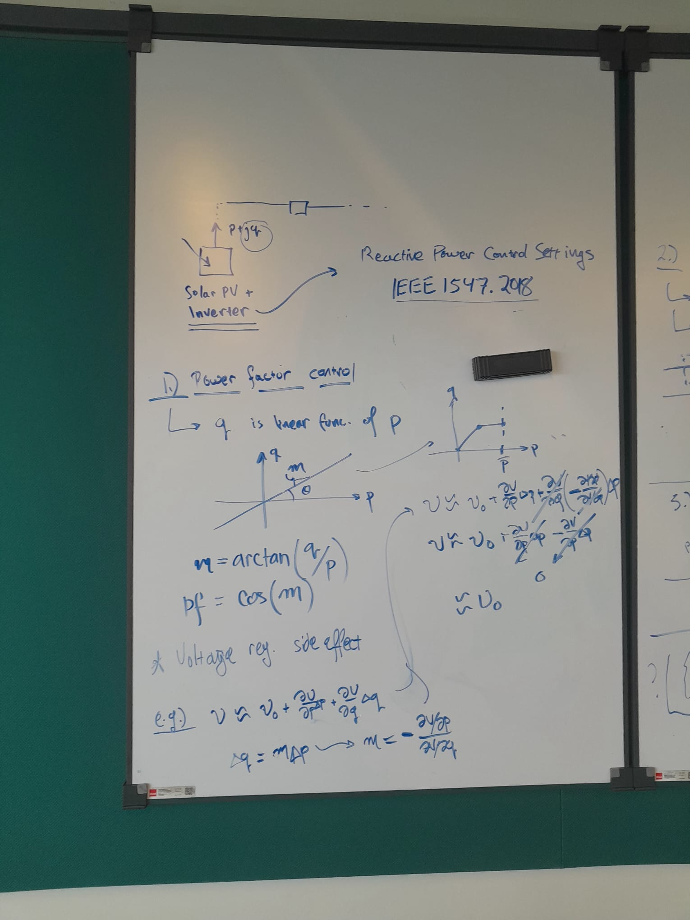
Simple Euclidean Distance Method
Approach:
Generate Synthetic Data: Create synthetic data for each control mode (Volt-VAR, Volt-Watt, Power Factor, No PV) based on theoretical graphs. These graphs are scaled and normalized to ensure proper comparison.
Calculate Euclidean Distance: For the new data, calculate the Euclidean distance between each point in the new data and the corresponding points in each synthetic control mode graph. Sum the distances to get a total distance measure for each control mode.
Determine Best Match: The control mode with the smallest total Euclidean distance to the new data is considered the best match.
2

Slide 4
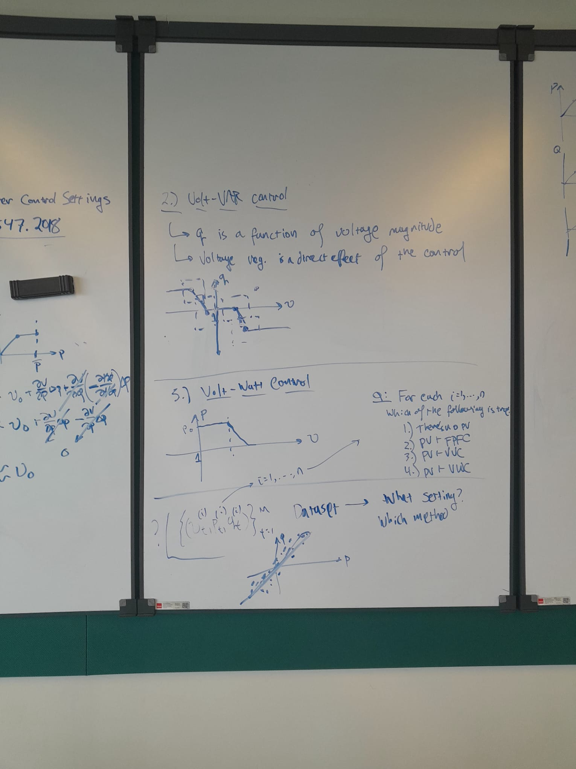
Random Forest Classification Method
Approach:
Generate Training Data: Create synthetic datasets for each control mode with labeled data. Combine these datasets into a single training set.
Train Random Forest Classifier: Use the synthetic training data to train a Random Forest classifier. The classifier learns to distinguish between different control modes based on the synthetic data.
Predict Control Mode for New Data: Use the trained Random Forest model to predict the control mode for the new data. Print the final predicted control mode.
3

Slide 5
Project Update: 1
Understanding the Theory

Slide 6
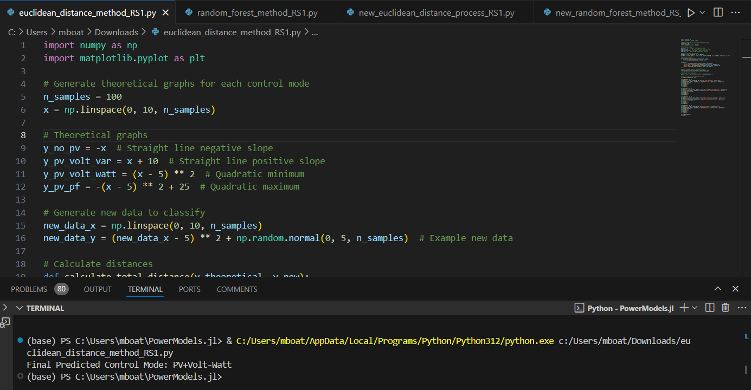
Test Run (Code + Graph)

Slide 7
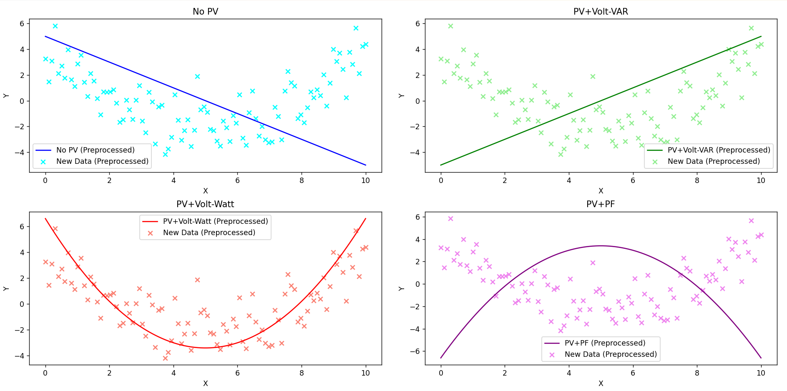
Test Run (Code + Graph)

Slide 8
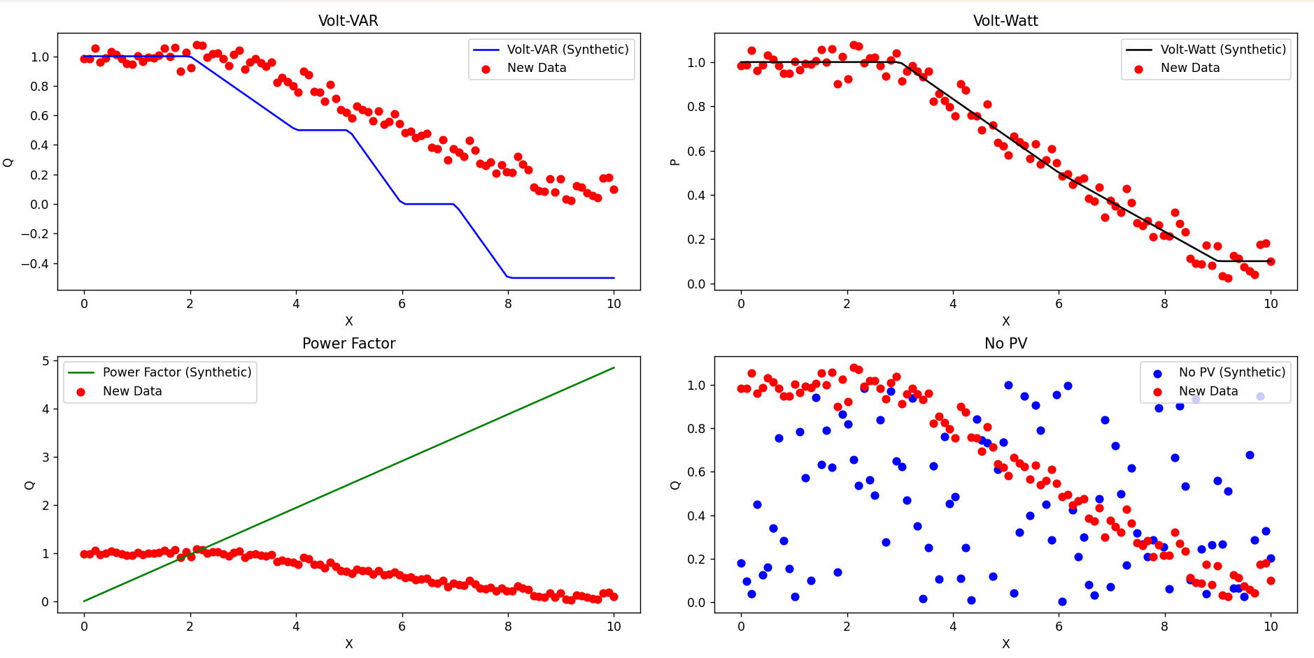
Euclidean Distance (Code + Graph)

Slide 9
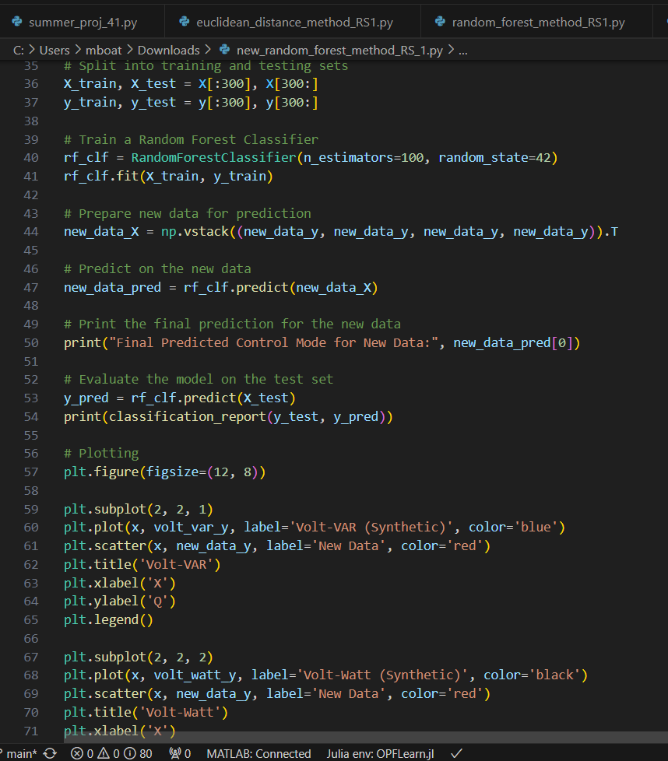
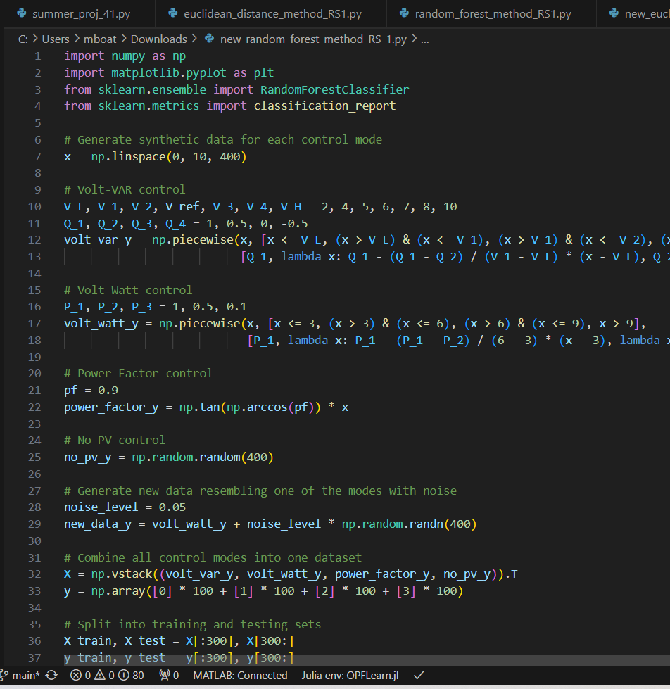
Random Forest (Code + Graph)

Slide 10
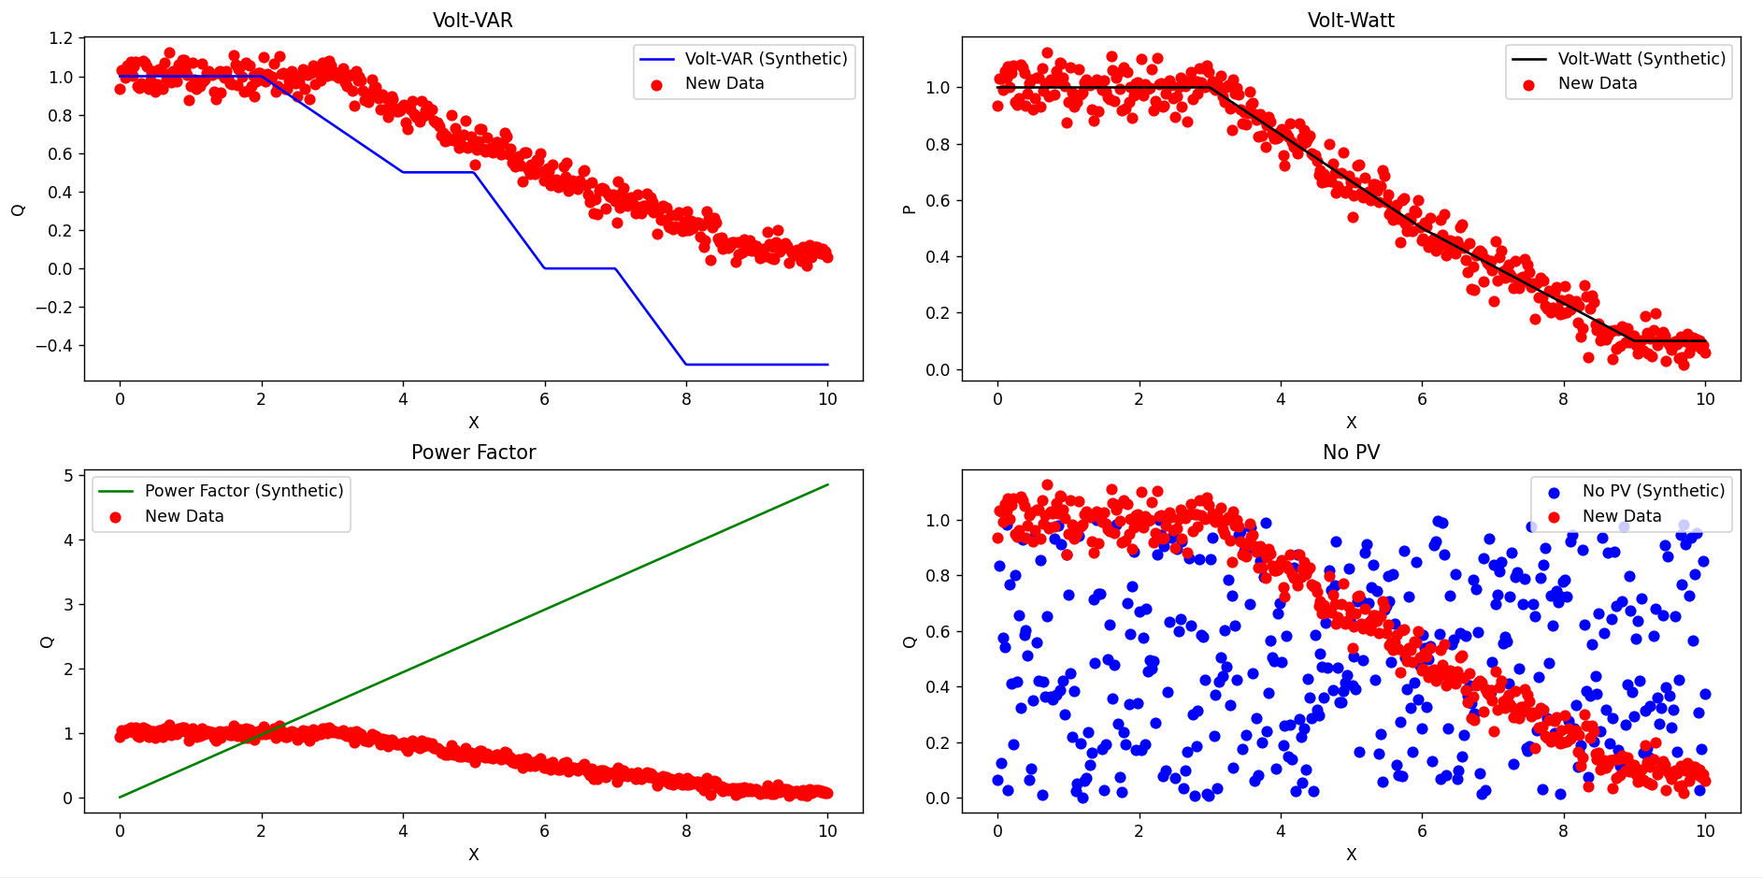
Random Forest (Code + Graph)

Slide 11
Project Update: 2
Exploring the Datasets I: Random Plots for Trends

Slide 12
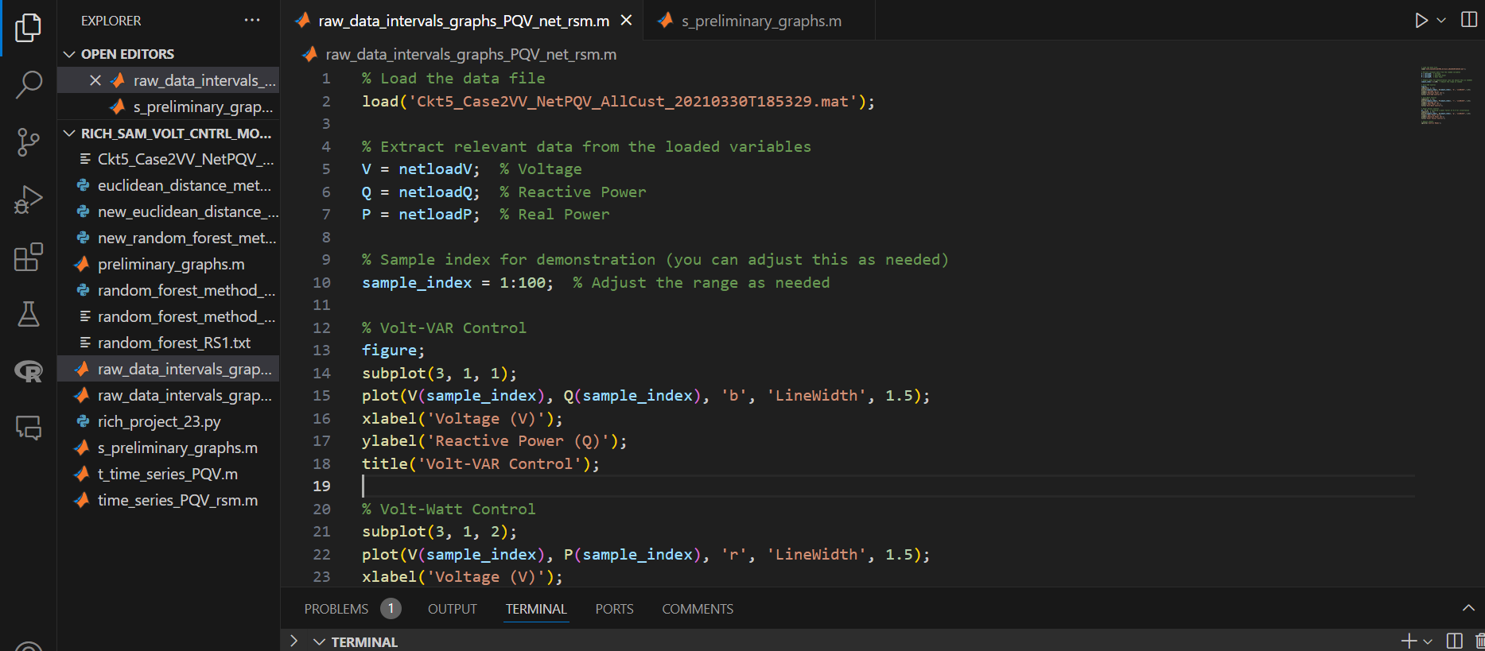
Raw Voltage Control Code

Slide 13
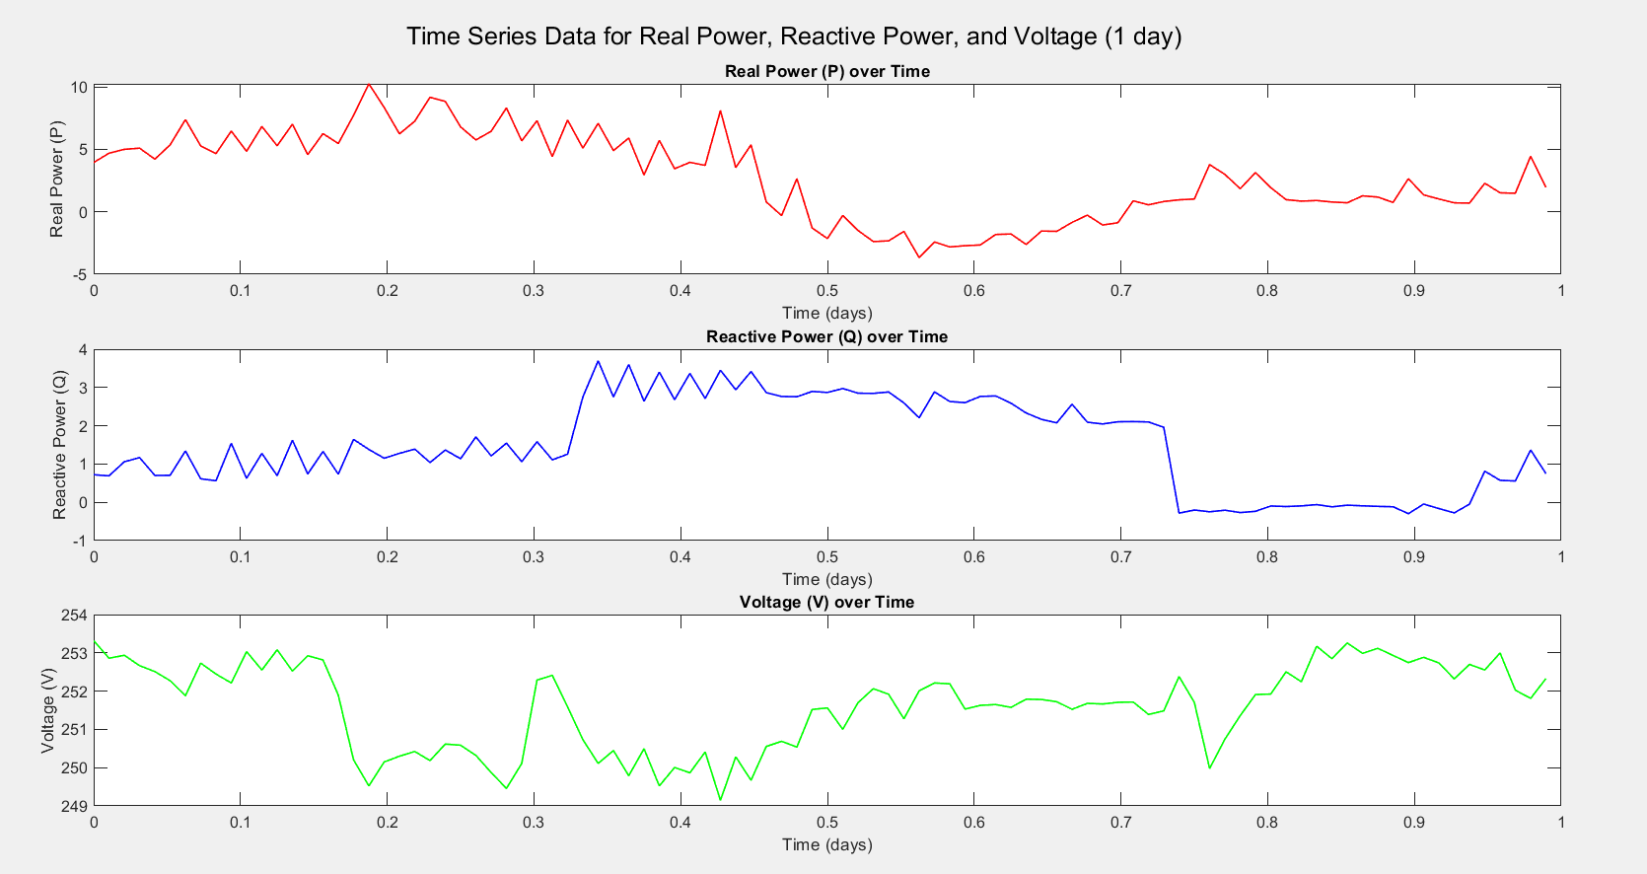
Function to Plot Time Series [in Intervals – 1 day]

Slide 14
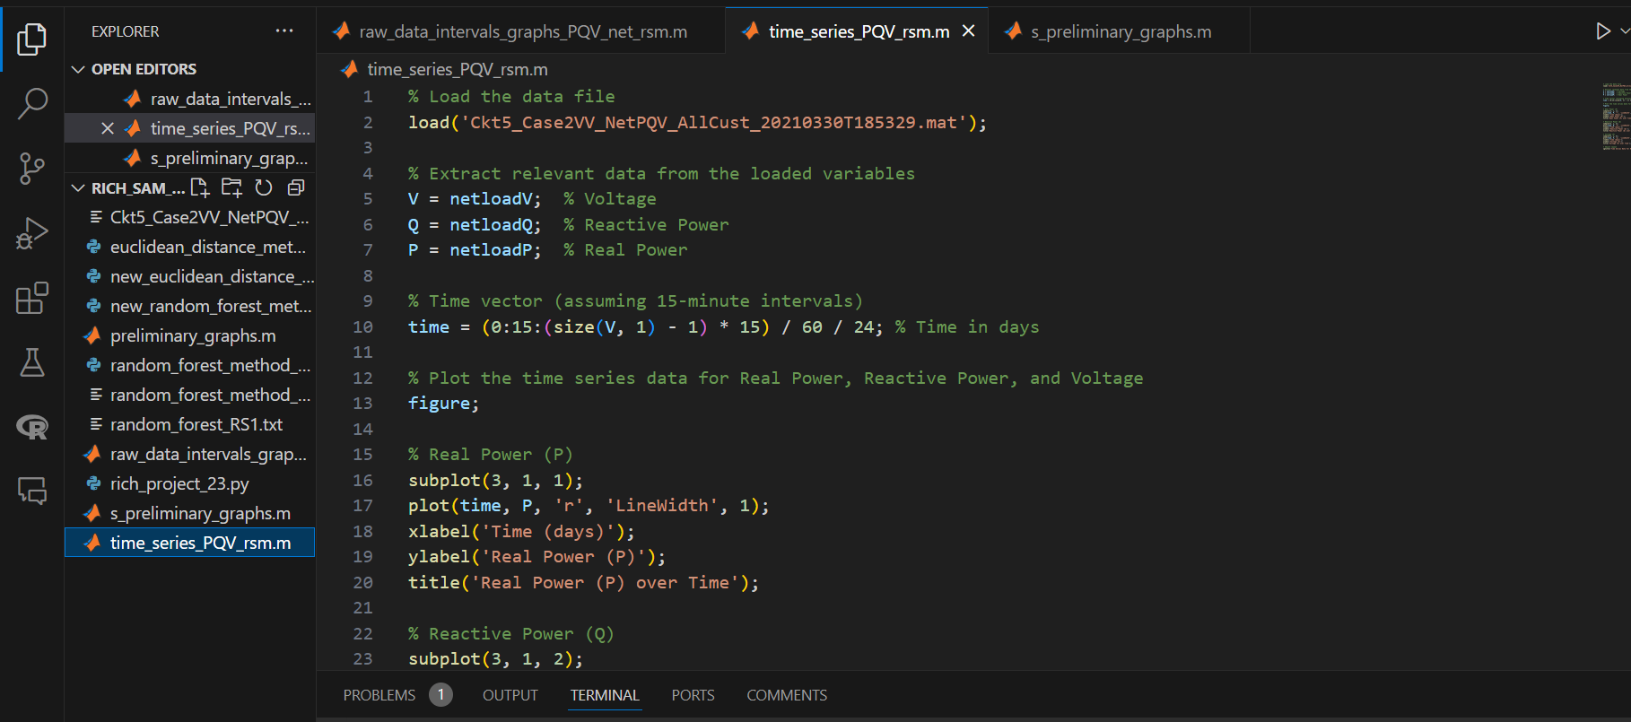
Function to Plot Time Series Code

Slide 15
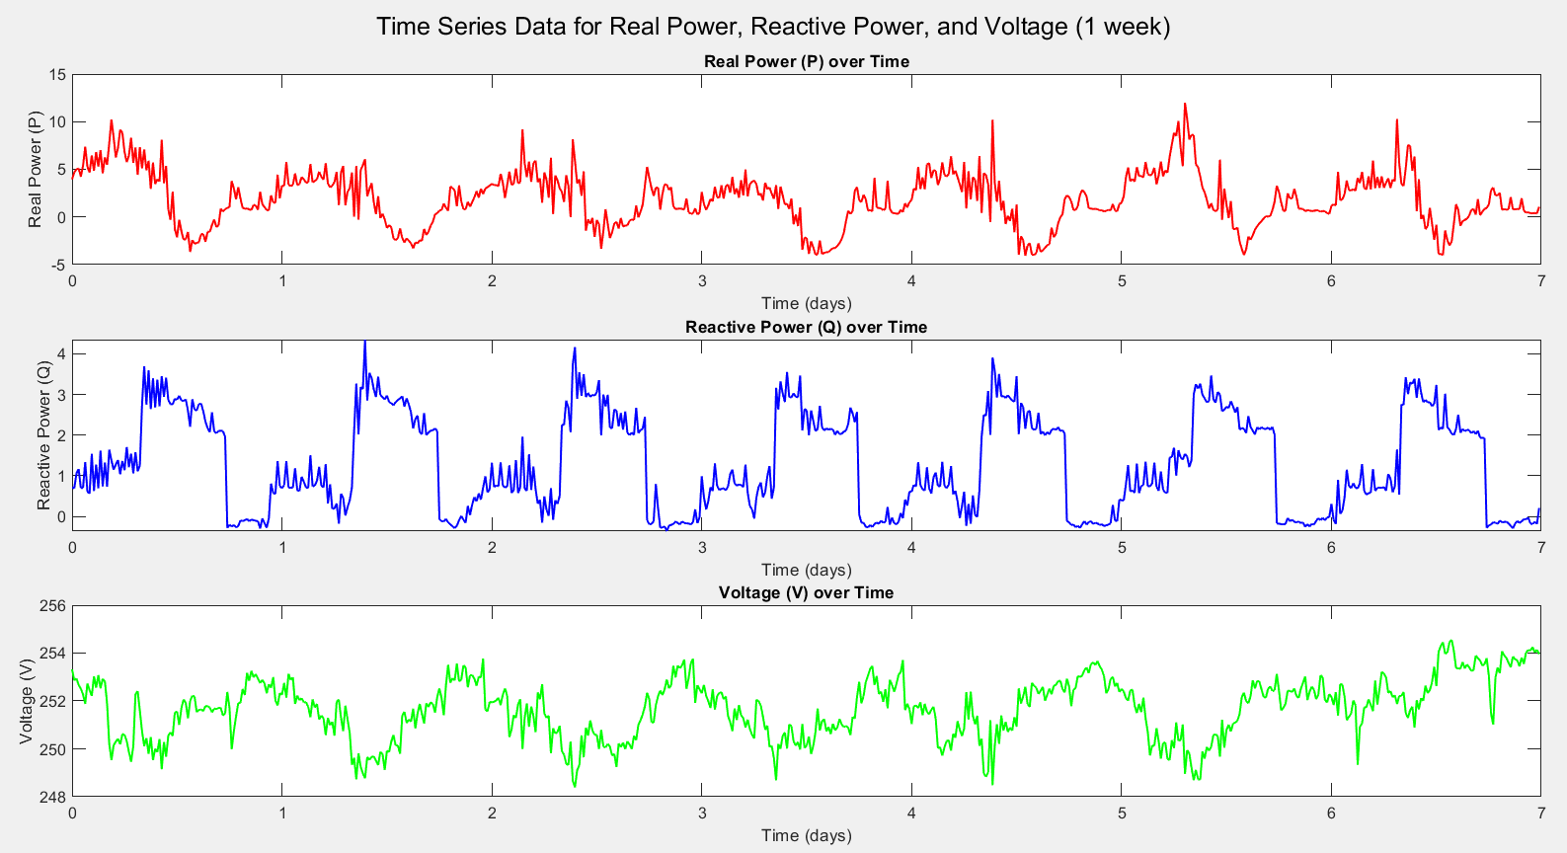
Plotting Time Series [in Intervals – 1 week]

Slide 16
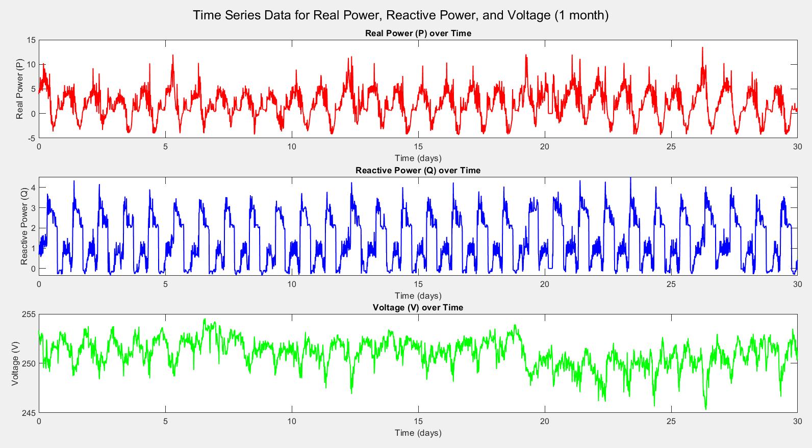
Plotting Time Series [in Intervals – 1 month]

Slide 17
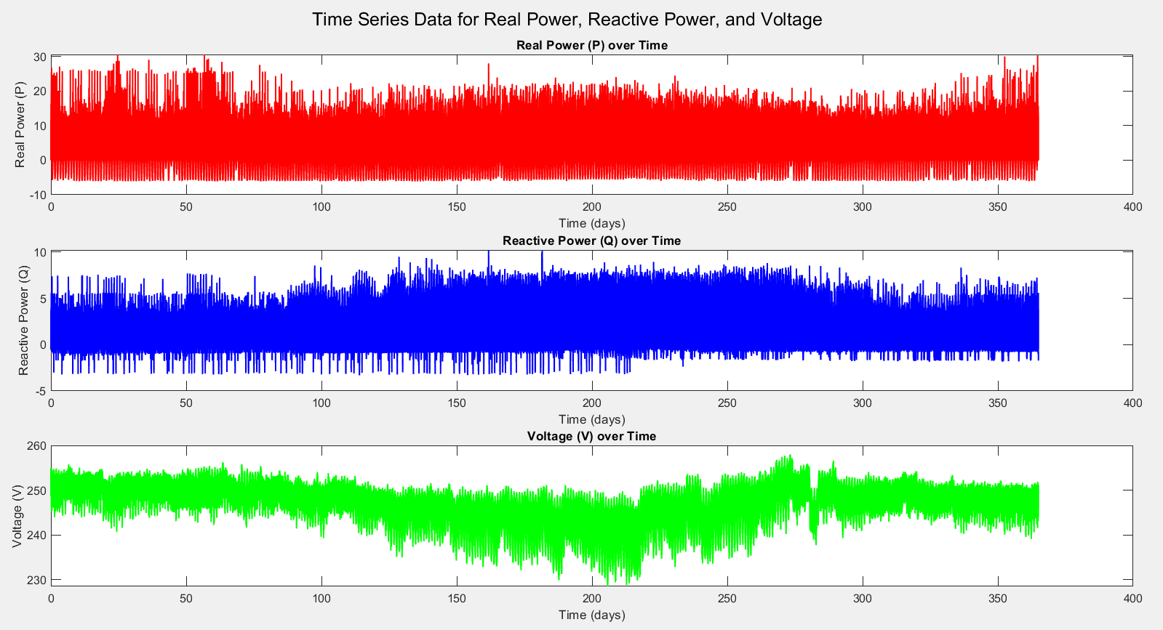
Plotting Time Series [in Intervals – 1 year]

Slide 18
Plotting Time Series [in Intervals – 1 month]

Slide 19
Project Update: 3
Exploring the Datasets II: Various Components in the Structured Data

Slide 20
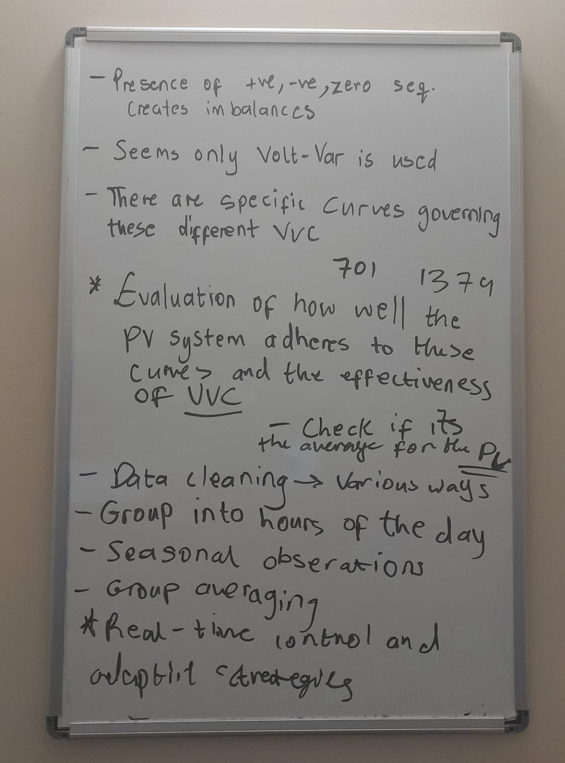
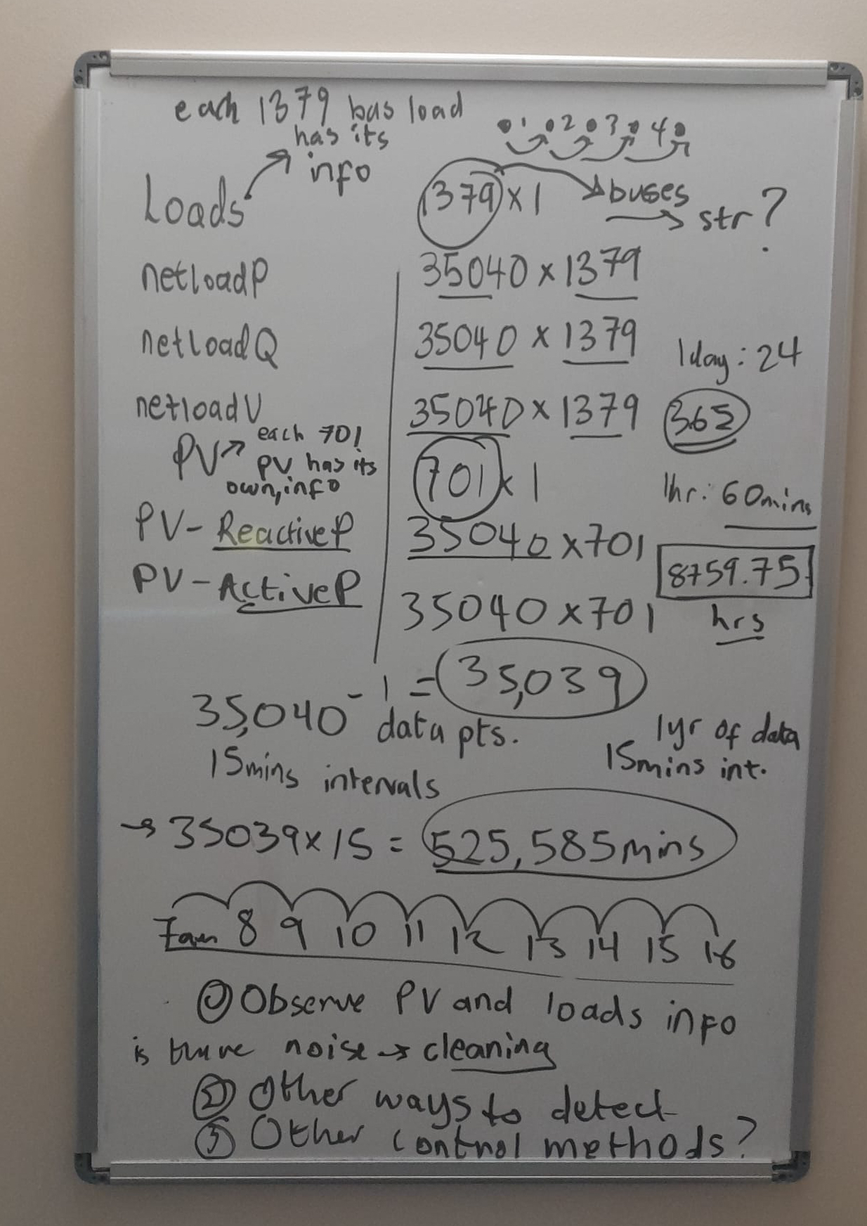
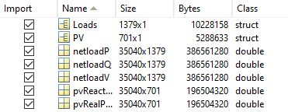
Analysis on the Dataset
Looking at the PV and V datasets more closely.
Calculating the 240.0045 V – Nominal voltage
Ways to group or clean the data (for different durations and seasons). Durations ranging from 1 day to 1 year. Seasonal data ranging from summer to winter.
Evaluating how well the PV systems adheres to these curves and the effectiveness of the modes.
Seperating buses into no-PV connected, PV connected.
If PV-connected, is it: VVC, or no VVC?
-If no VVC connected, is it PF control (i.e PF=1 or PF<1)?
Cross-reference bus datas in PV, and load then to
-> pVR/ pVQ or netloadP/ netloadQ / netloadV

Slide 21
Exploring Volt-VAR Control (VVC) Mode

Slide 22
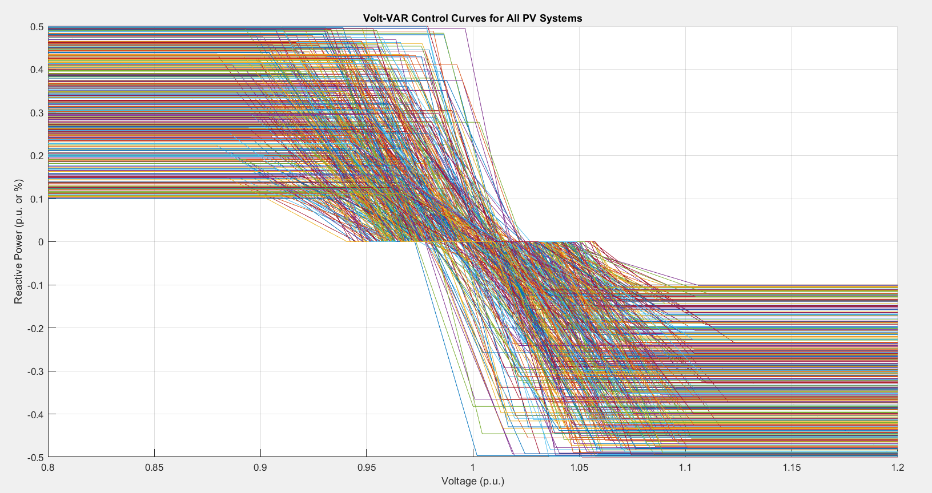
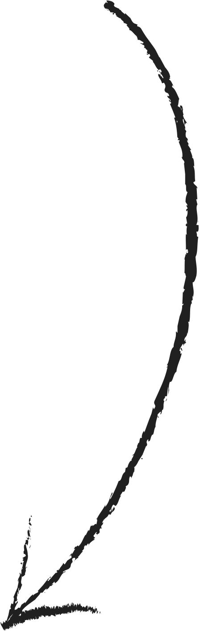
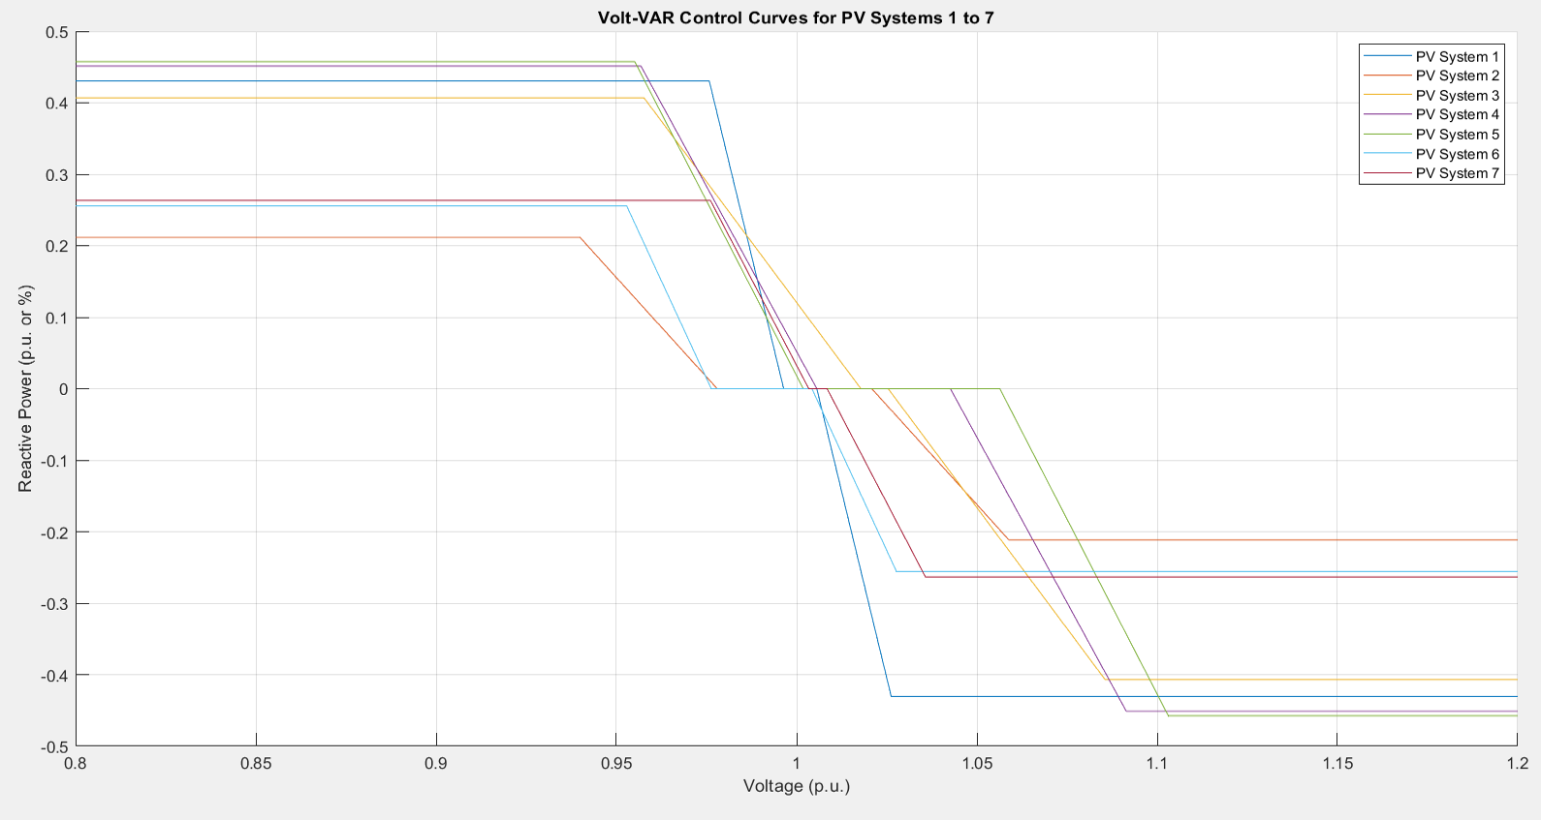
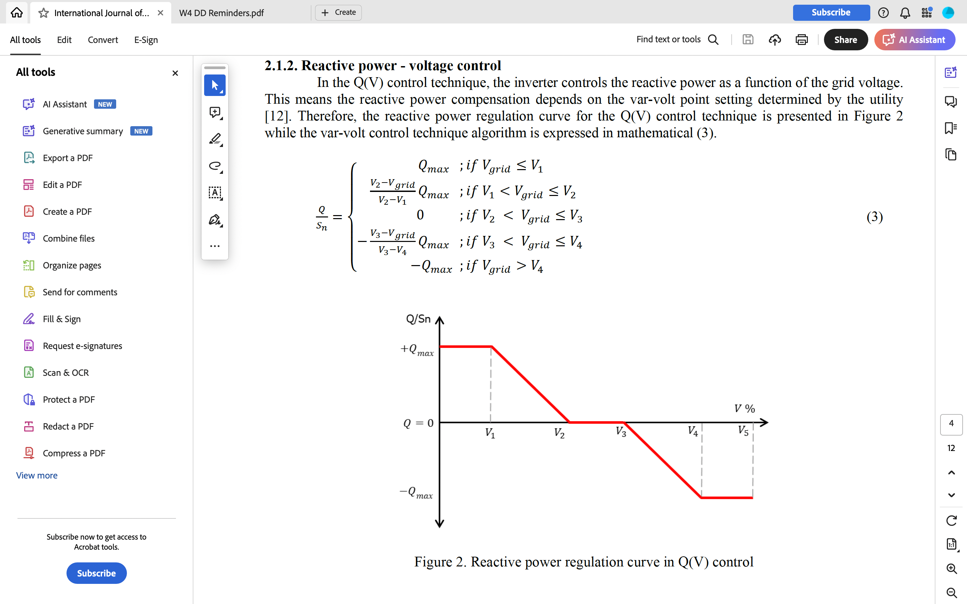
Actual VVC Mode Graphs from PV
PV data
Observing the PV (35040x751) and V(35040x1379) datasets: I noticed we have access to the labelled VVC PVs. This will help us fact check our methods.
The curves to the right are what governs the VVC modes for the PV/Inverters, they look good! And definitely agree with the literature.
Journal homepage: http://ijape.iaescore.com Reactive power control of solar photovoltaic inverters for grid code compliance support

Slide 23
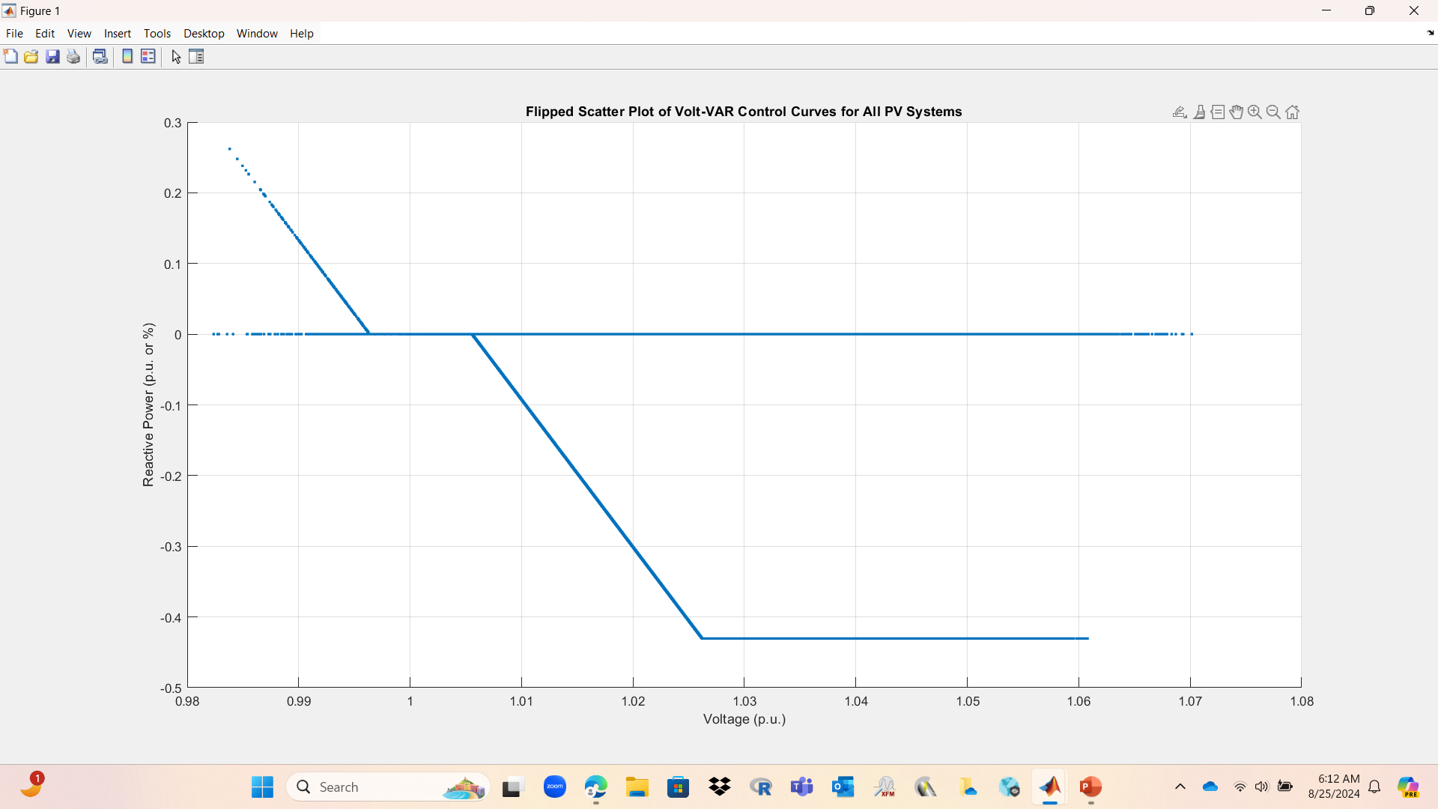
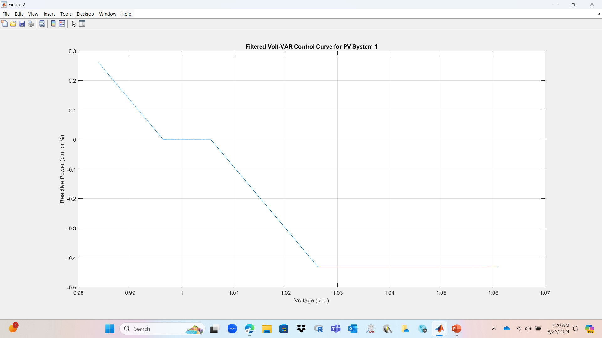
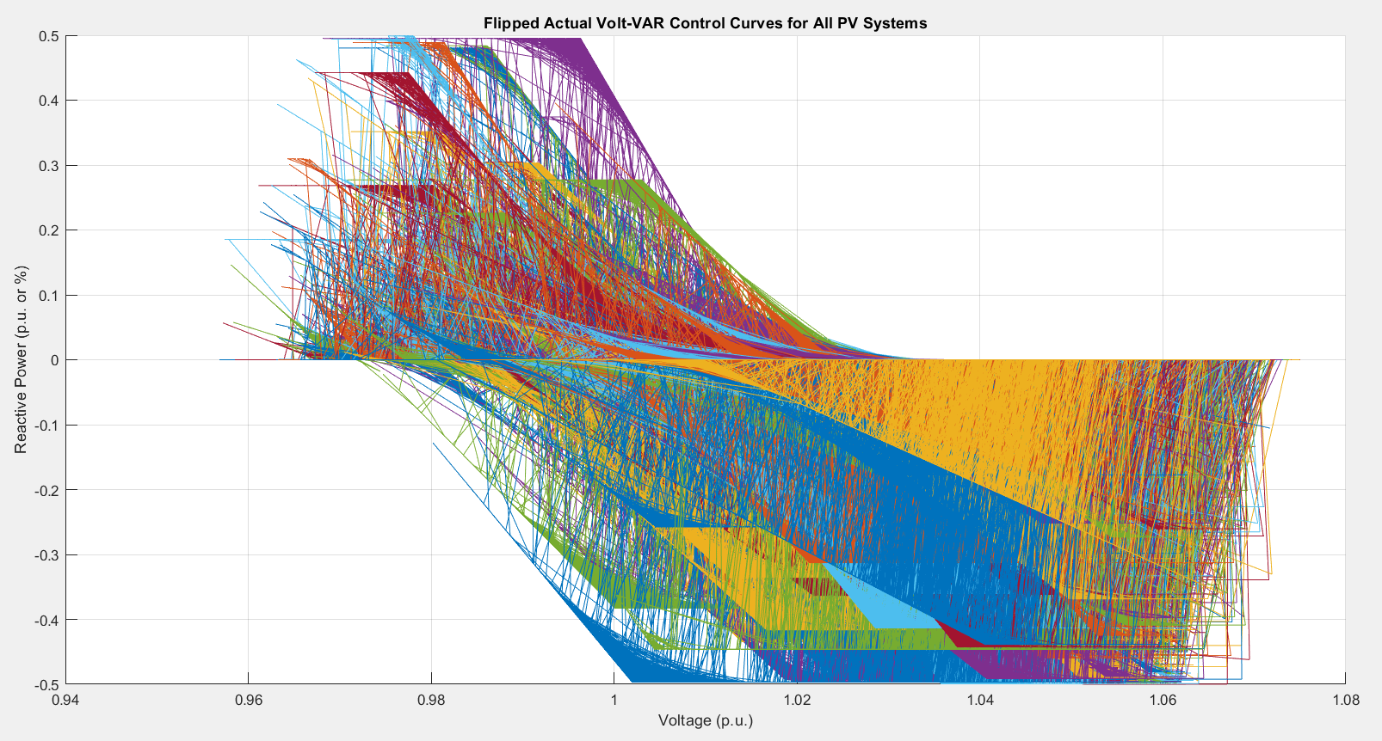
Measured VVC Mode Graphs from PV
PV data
Sketched pvReactivePower vs. Voltage. The PV reactive power is in p.u. or %, this was Q/Sn.
The data looks good and translates well to the actual VVC modes that govern them.
Some reconstruction needed to be done. Like removing all zeroes, and then connecting the remaining lines…including the ones that form the deadband. And flipping signs.
Pretty 🥹
but meaningless

Slide 24
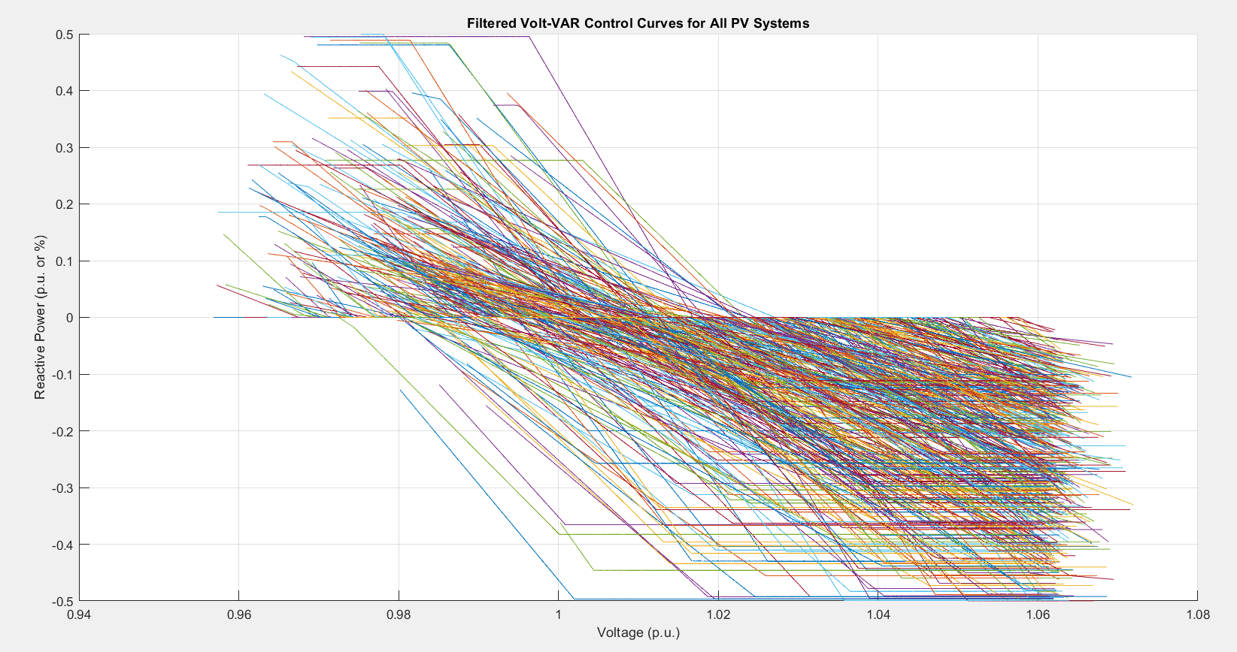
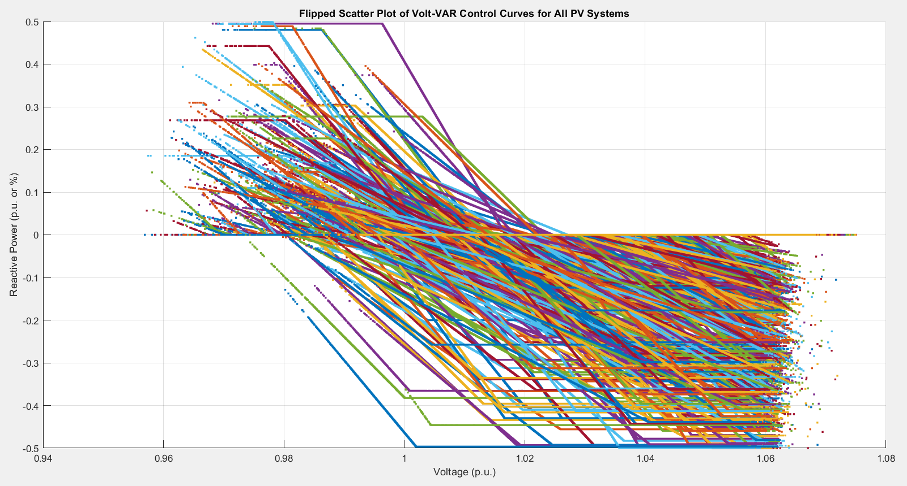
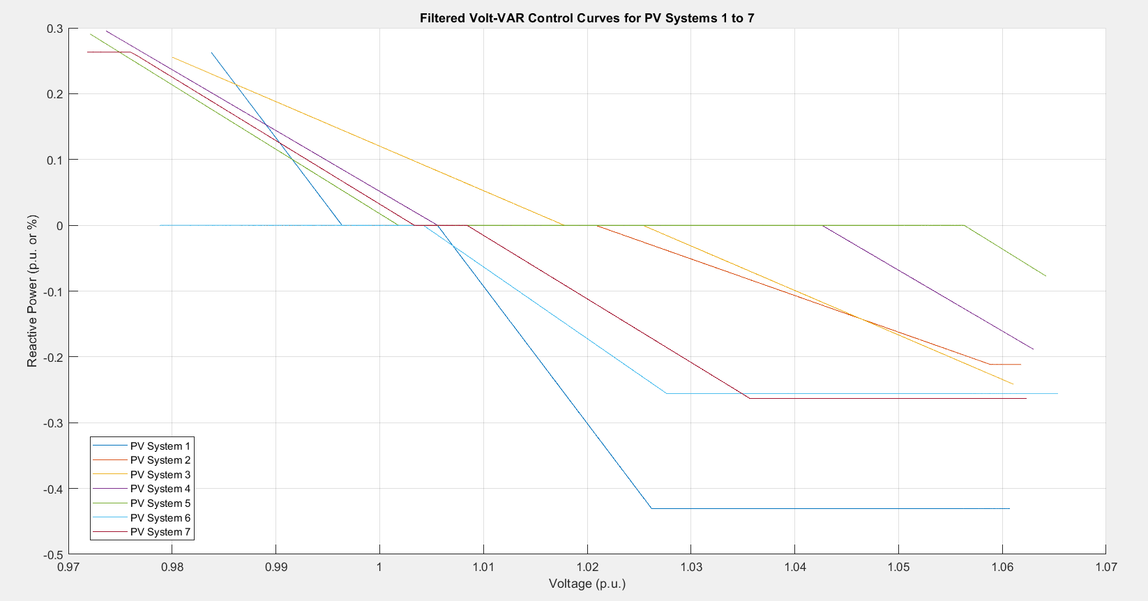
Measured VVC Mode Graphs from PV
PV data
Pretty 🤩, and meaningful
PV System | Mean Squared Error
1 | 0.0007
2 | 0.0023
3 | 0.0004
4 | 0.0072
5 | 0.0085
6 | 0.0011
7 | 0.0001
Overall | 0.0029
Sketched all VVC controlled panels.
Plotted subset of only the first
7 panels.

Slide 25
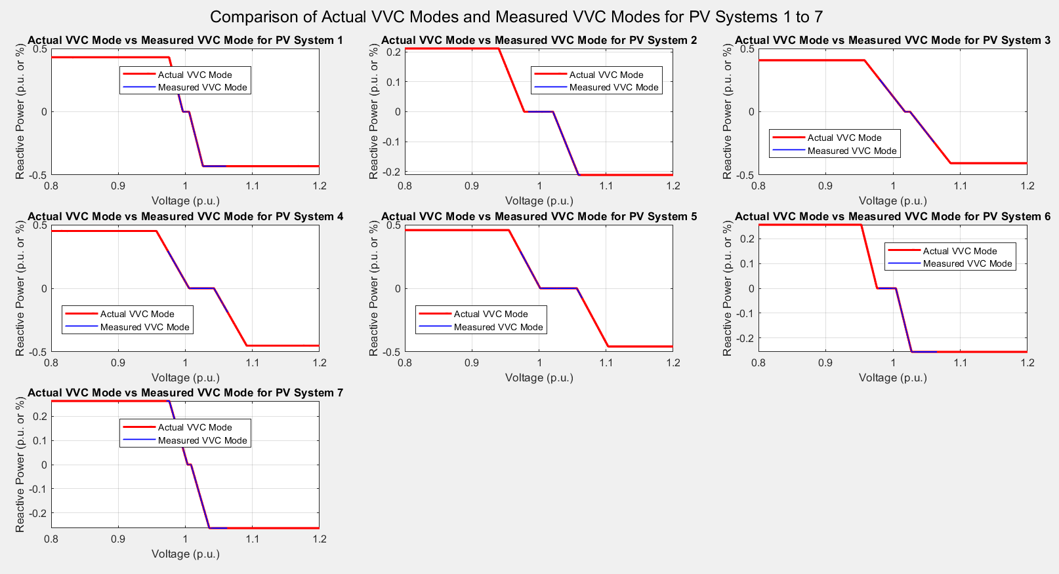
Comparing Actual vs Measured VVC Mode Graphs from PV
PV data
The 7 measured curves translates well…albeit not fully, to their corresponding VVC rules.

Slide 26
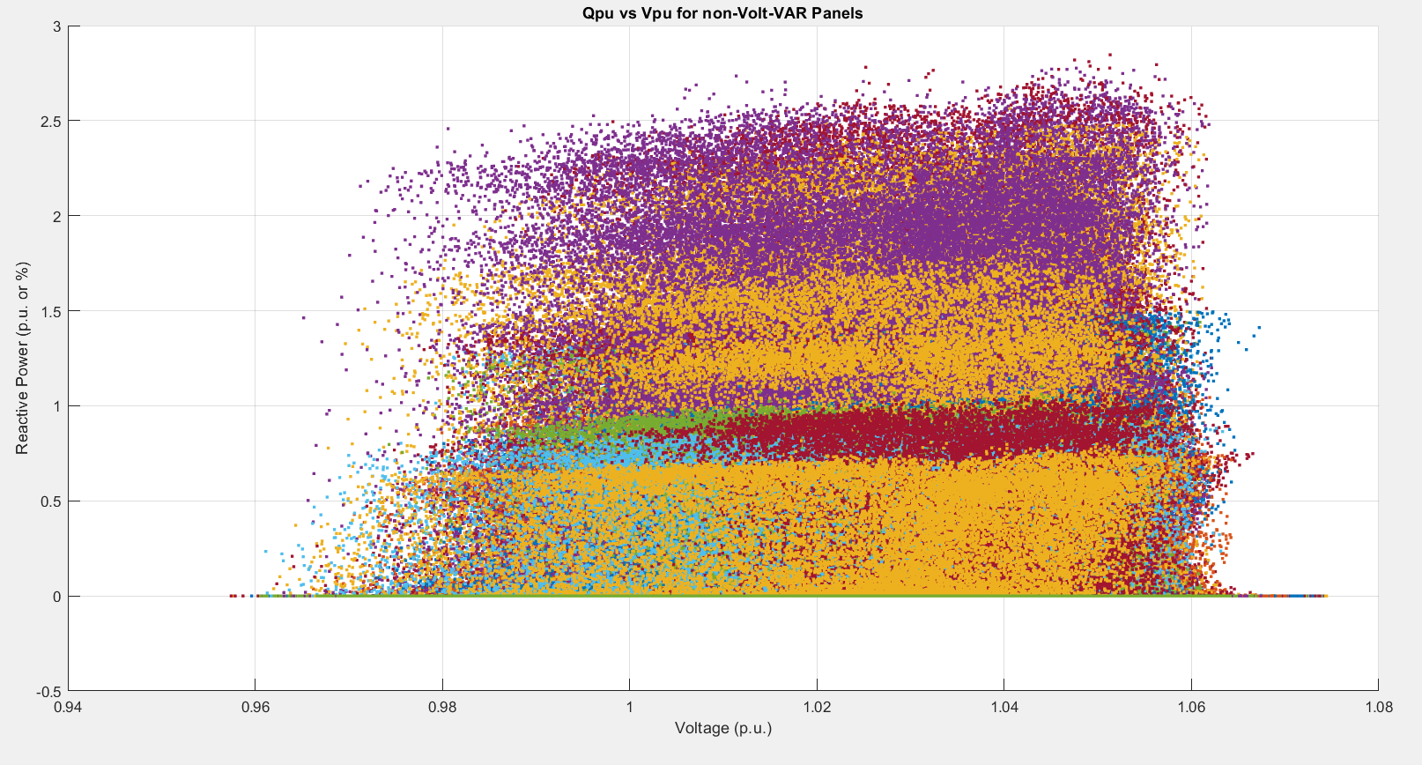
Measured Non-VVC Mode Graphs
PV data
Plotted non-VVC mode graphs (Qpu vs. Vpu)
Plotting non-VVC modes within PV structured data (701), means although they are non-VVC, they could be other controls.

Slide 27
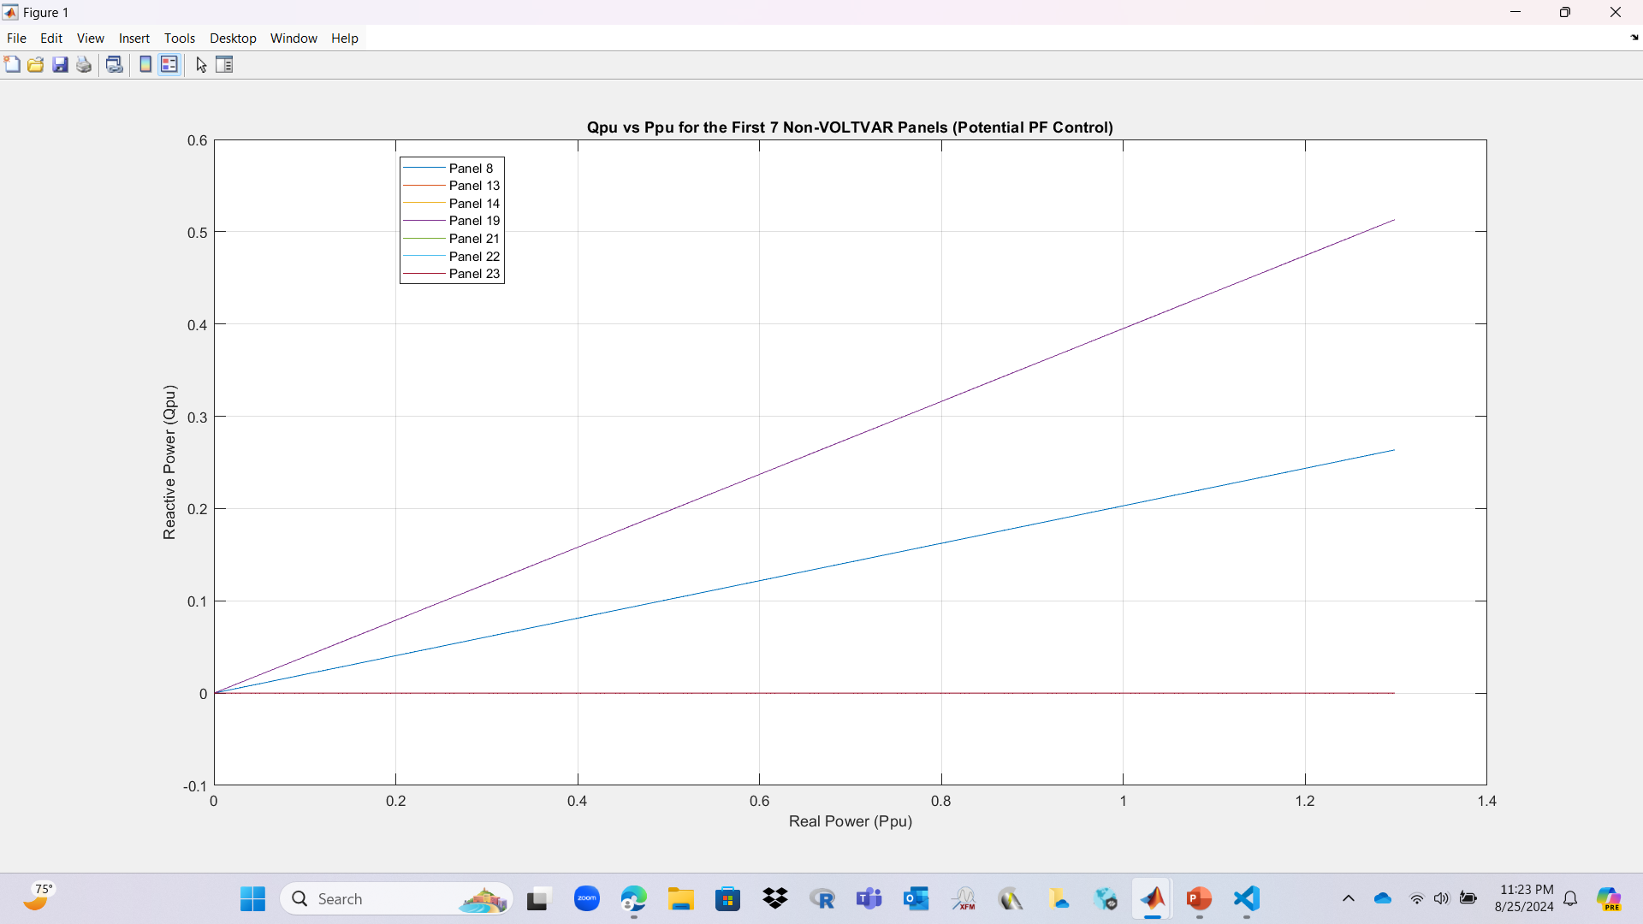
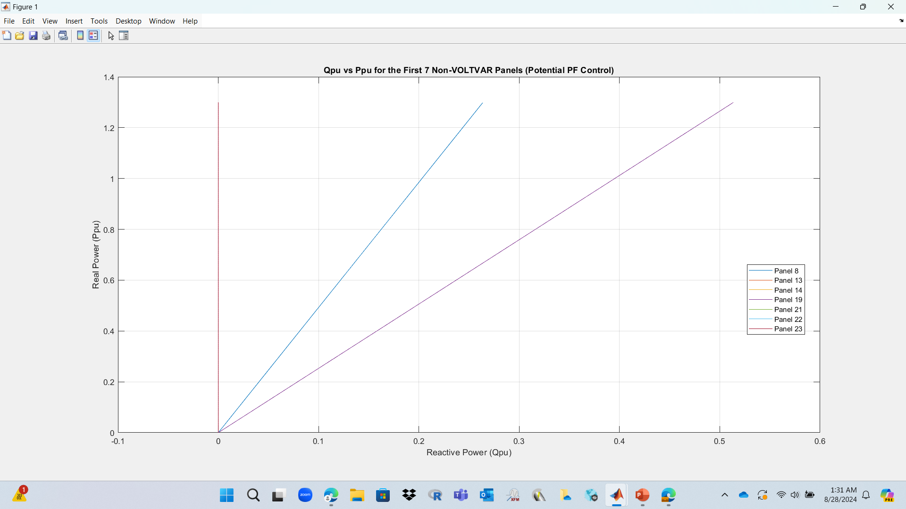
Measured Non-VVC Mode Graphs (PF)
PV data
The PF controls that had a PF<1, where panels 8 and 13. The data from pV reactive, had the same PFs as the PV structured data.
The graphs also agree with literature of PF control with PF<1, and PF=1.
Comparison with literature in the next slide 🛝
PV System | Gradient | Power Factor
8 | -0.20906 | 0.97884
13 | 2.4428e-12 | 1
14 | 3.2437e-12 | 1
19 | -0.40858 | 0.92571
21 | 3.4731e-12 | 1
22 | 2.6686e-12 | 1
23 | 2.8743e-12 | 1

Slide 28
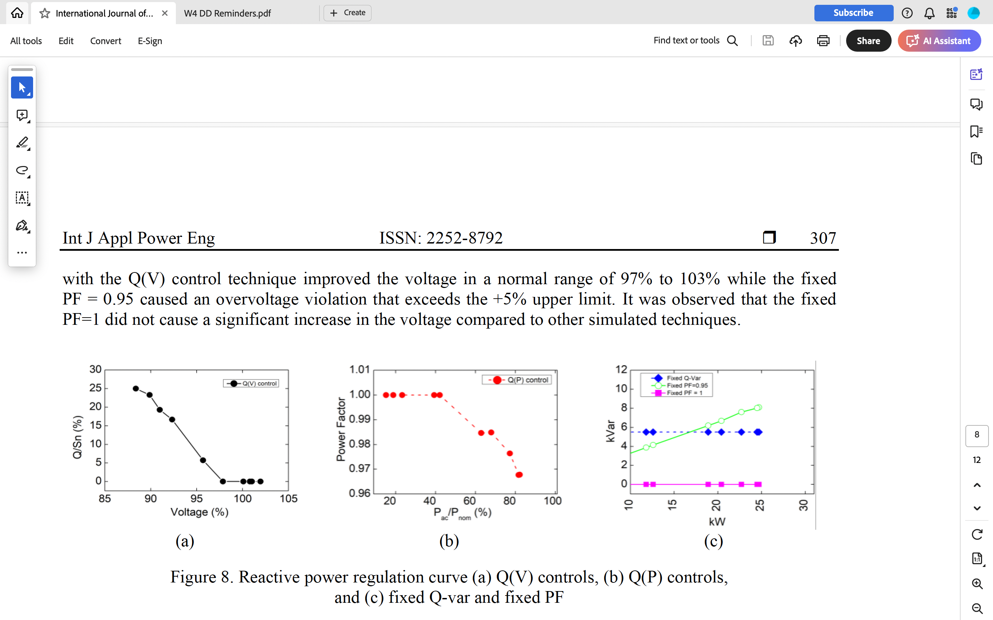
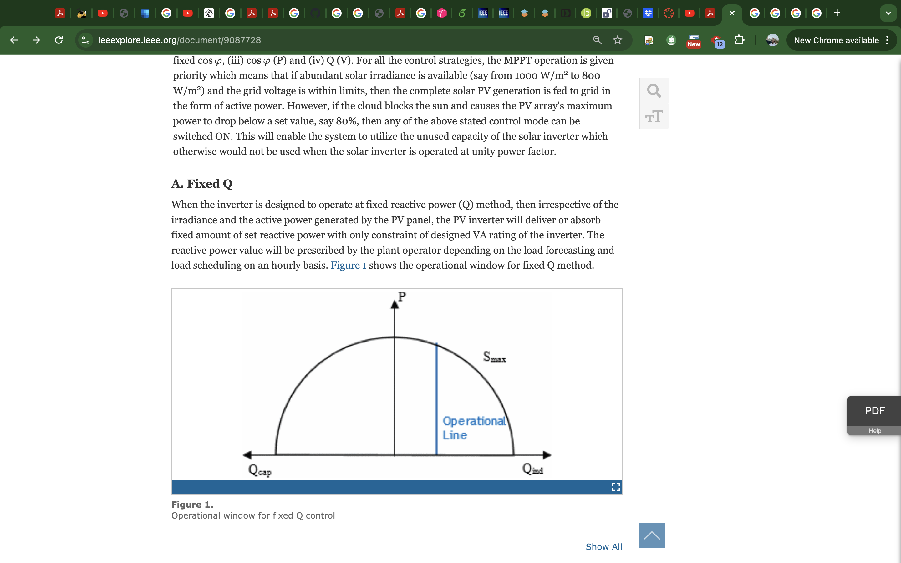
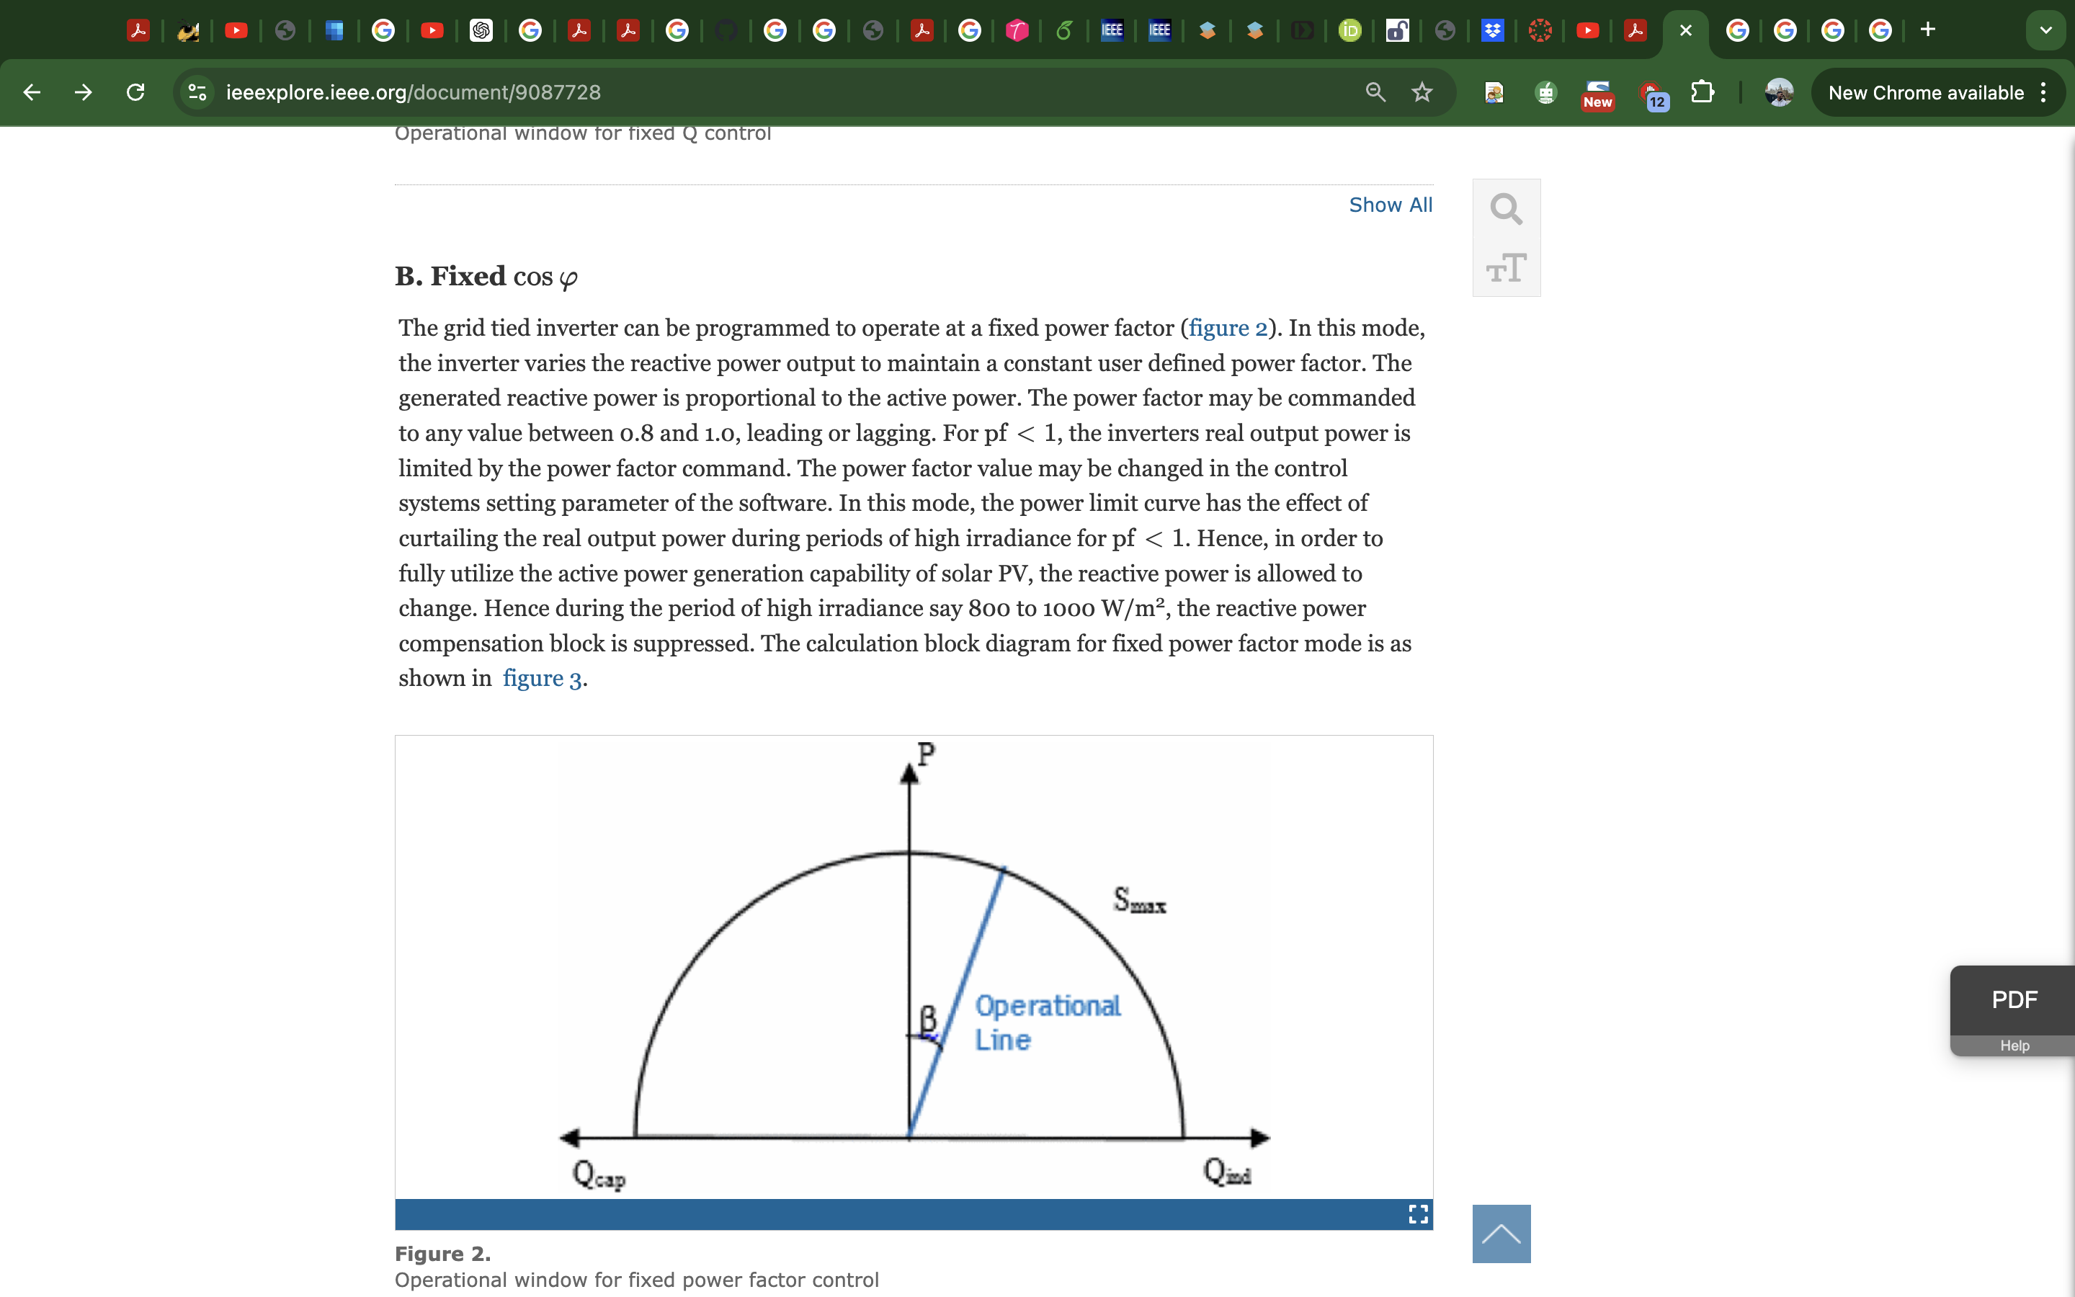
Measured Non-VVC Mode Graphs (PF)
PV data

Slide 29
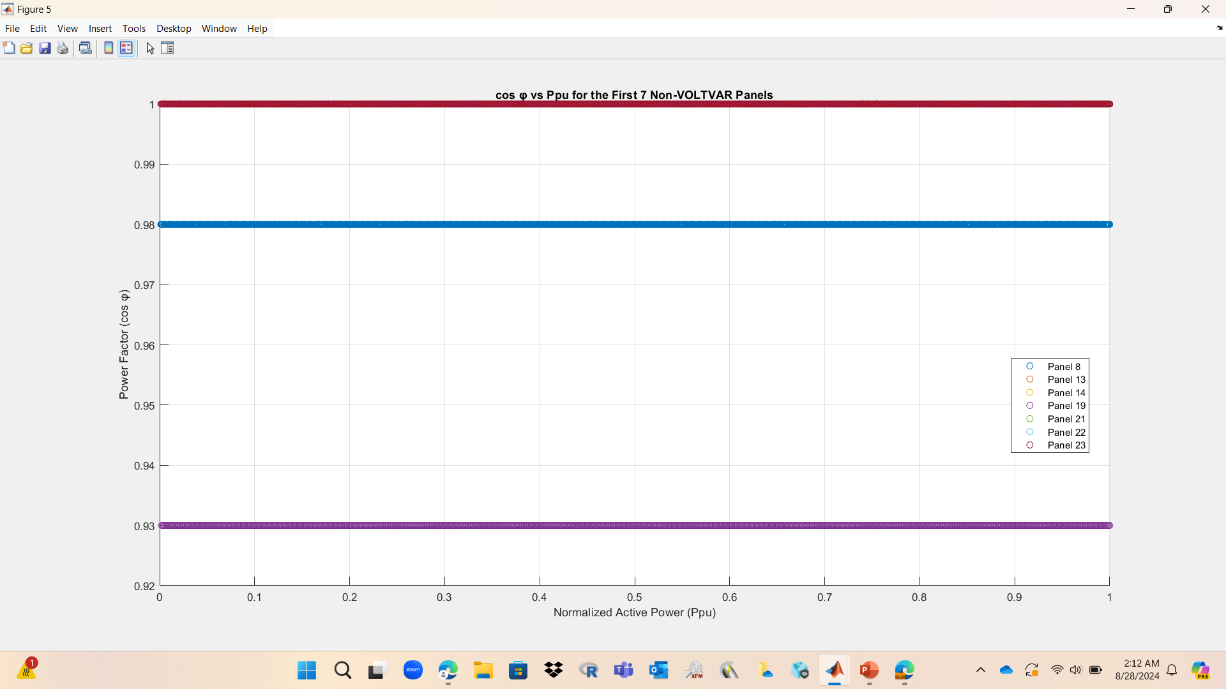
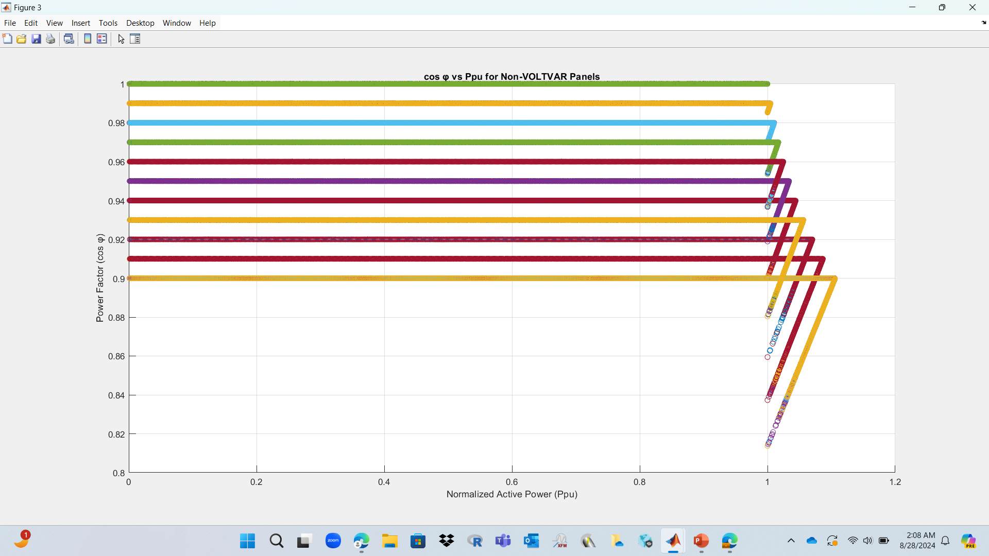
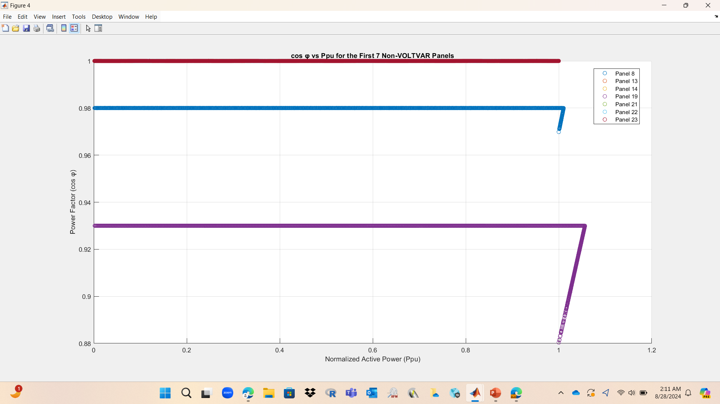
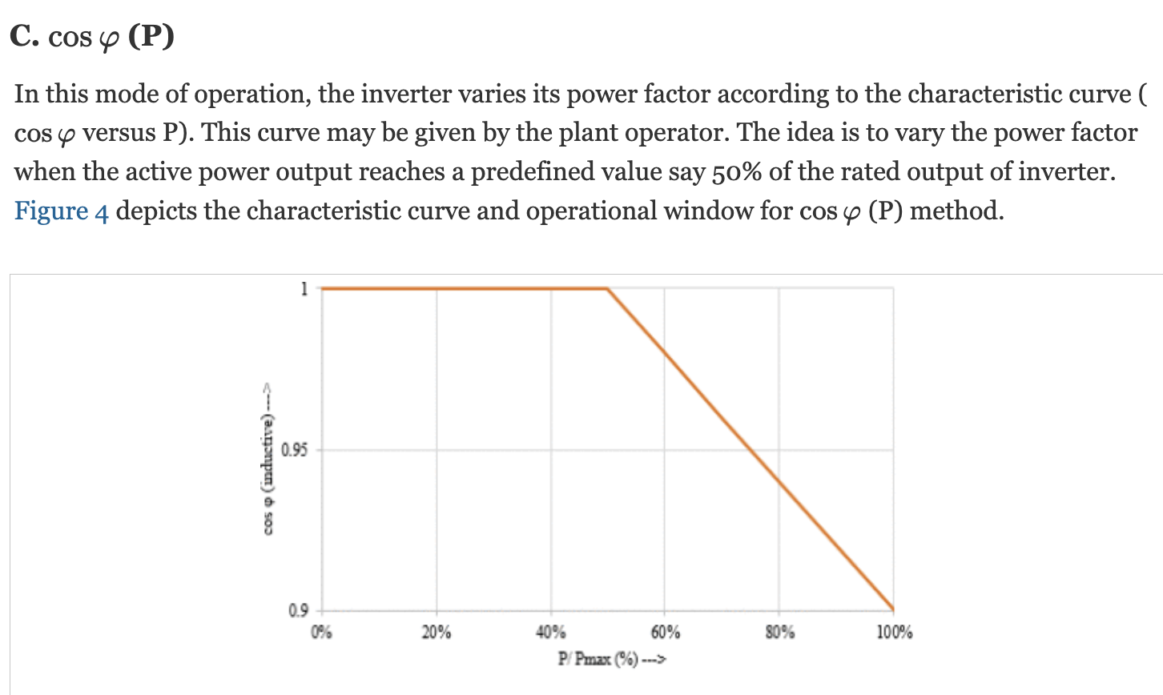
Measured Non-VVC Mode Graphs
PV data
Plotting PF vs. normalized active power to observe relationship.

Slide 30
Whole Year – Time Series Plots

Slide 31
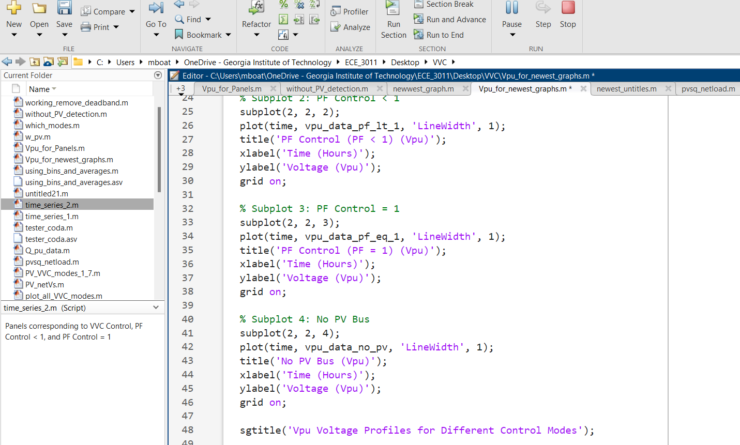
Mode Separation and Time Allocation
Load data
Volt-Var (VVC) Buses Identification:
Identified the buses in the PV structure with Volt-Var control (controlMode set to 'VOLTVAR’).
Extracted the corresponding bus names and found their indices in the Load structure. These indices were used to reference the correct buses in the netloadV data.
Excluding Volt-Var Buses:
After identifying the Volt-Var buses, these were excluded from the remaining set of buses to avoid overlap when identifying PF < 1 and PF = 1 buses.
PF < 1 and PF = 1 Buses Identification:
From the remaining buses, I then identified those with PF < 1 and PF = 1 by referencing the PF field in the PV structure.
The bus names corresponding to these control modes were extracted and cross-referenced with the Load structure to get the correct indices for the netloadV data.
No PV Buses Identification:
Buses that do not have any corresponding PV panels were identified by comparing the bus names in the Load structure with those in the PV structure.
These buses were also cross-referenced with the Load structure to obtain their indices for the netloadV data.
Group | Description
Group 1 | Buses with no PV
Group 2 | Buses with PF control (PF < 1)
Group 3 | Buses with PF control (PF = 1)
Group 4 | Buses with VVC control

Slide 32
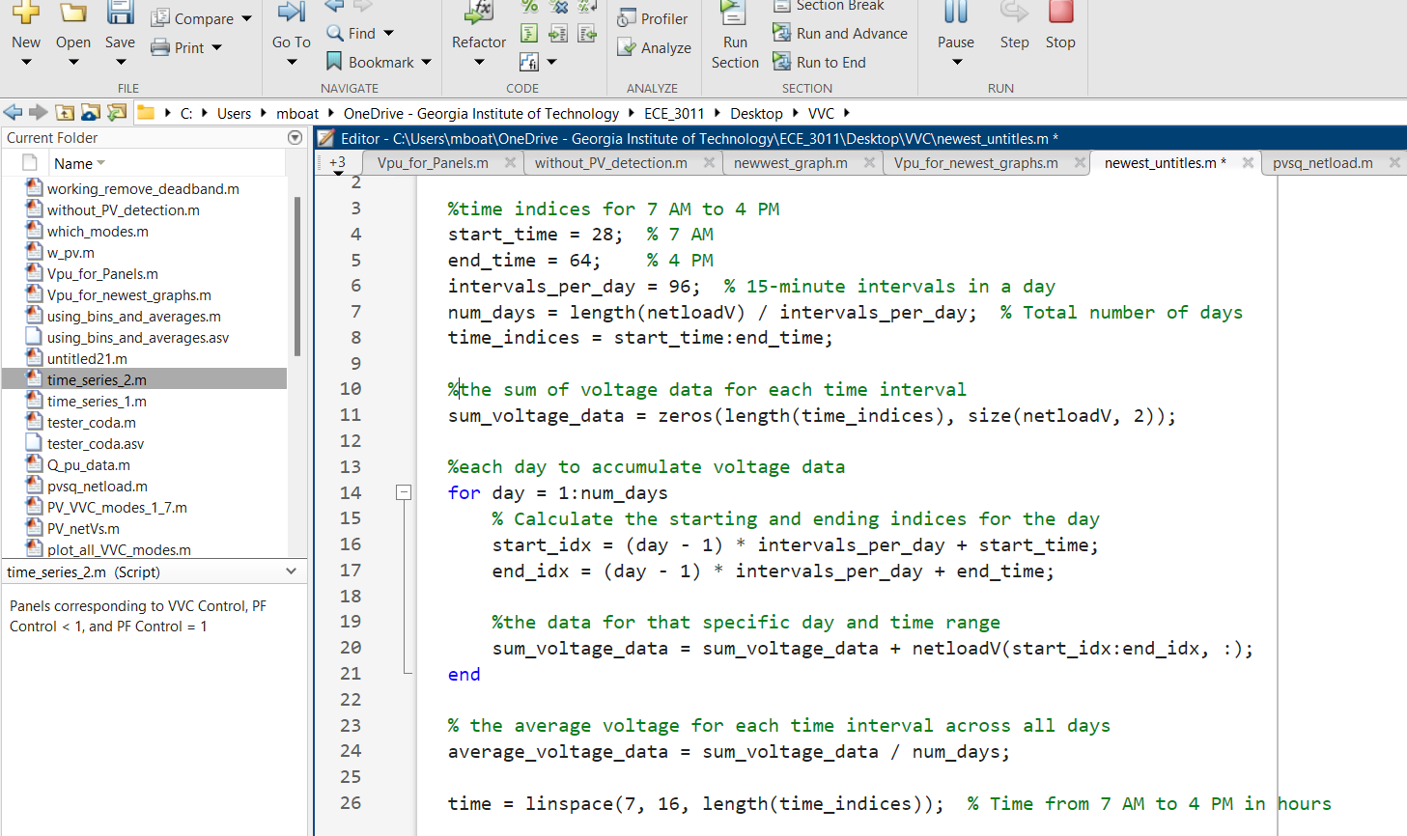
Mode Separation and Time Allocation
Load data
Time Indices Calculation for Averaging:
Purpose: I determined the time indices for 7 AM to 4 PM, which corresponds to indices 28 to 64.
Intervals Calculation: Each day has 96 intervals (15-minute intervals), and I calculated the number of days in a year based on the total length of the netloadV data.
Summation of Voltage Data:
Accumulation: I initialized an array to sum voltage data over each interval across all days.
Loop for Each Day: I looped over each day, accumulated the voltage data for the specific time range (7 AM to 4 PM), and added it to the sum array.
Averaging Across the Year:
Final Averaging: After summing the voltage data for all days, I divided the sum by the number of days to obtain the average voltage for each time interval across the year.
Time Vector Creation: The time vector was created from 7 AM to 4 PM to match the calculated intervals.

Slide 33
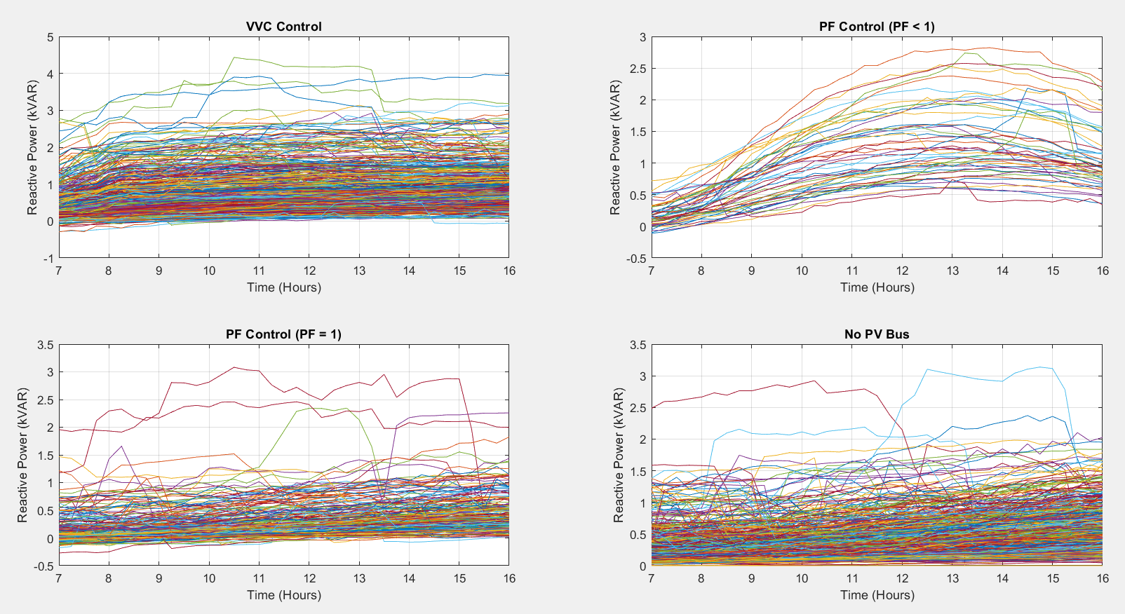
Net Reactive Power vs. Time
Load data

Slide 34
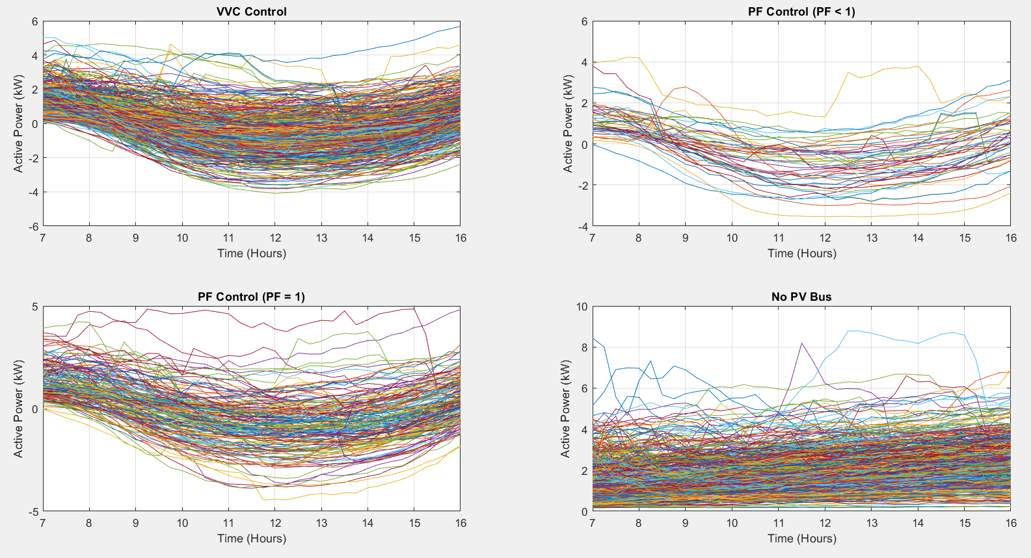
Net Active Power vs. Time
Load data

Slide 35
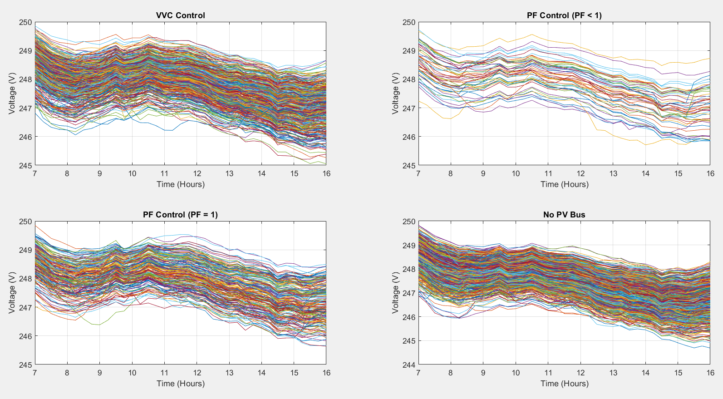
Net Voltage vs. Time
Load data

Slide 36
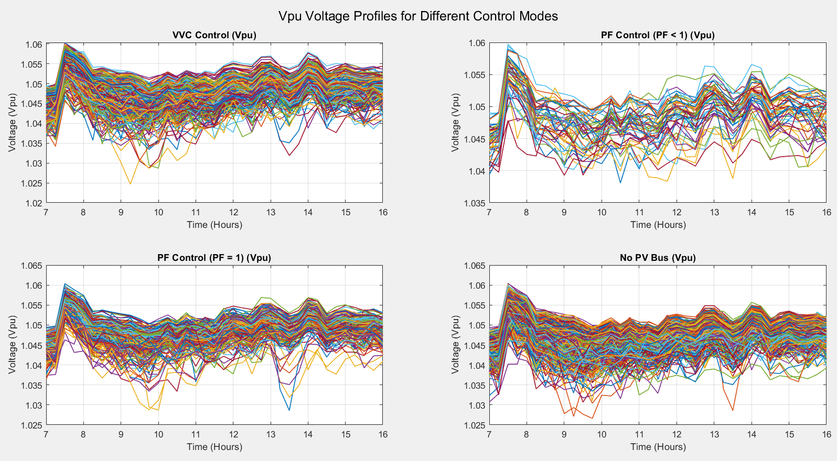
Net Voltage per unit vs. Time
Load data
We could look into voltage variation counts, to identify how many counts corresponds to the different control modes. 🧐
I think no-PV is a misnomer… no-PV bus is better.

Slide 37
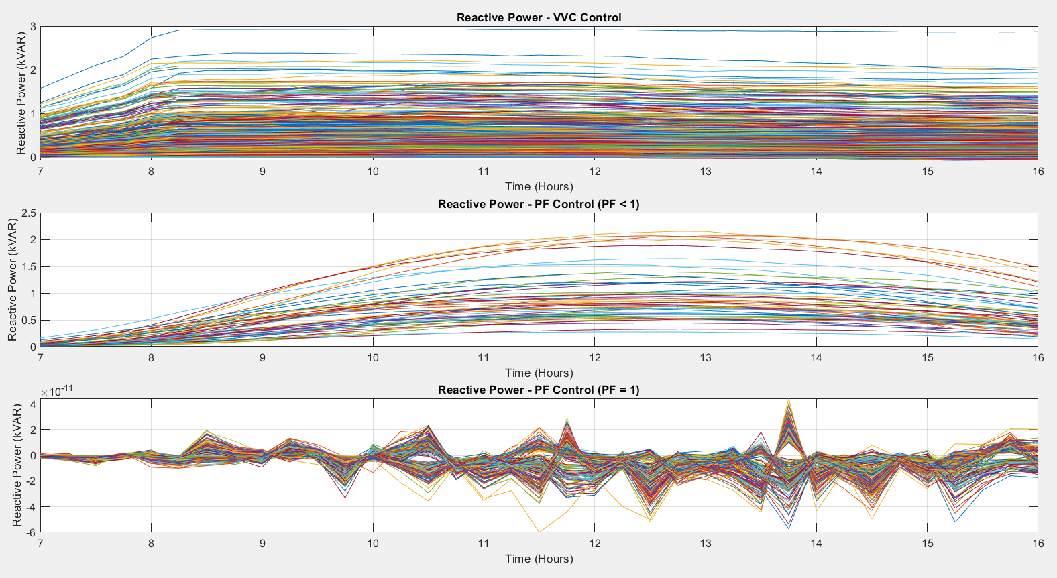
Net PV Reactive Power vs. Time
PV data

Slide 38
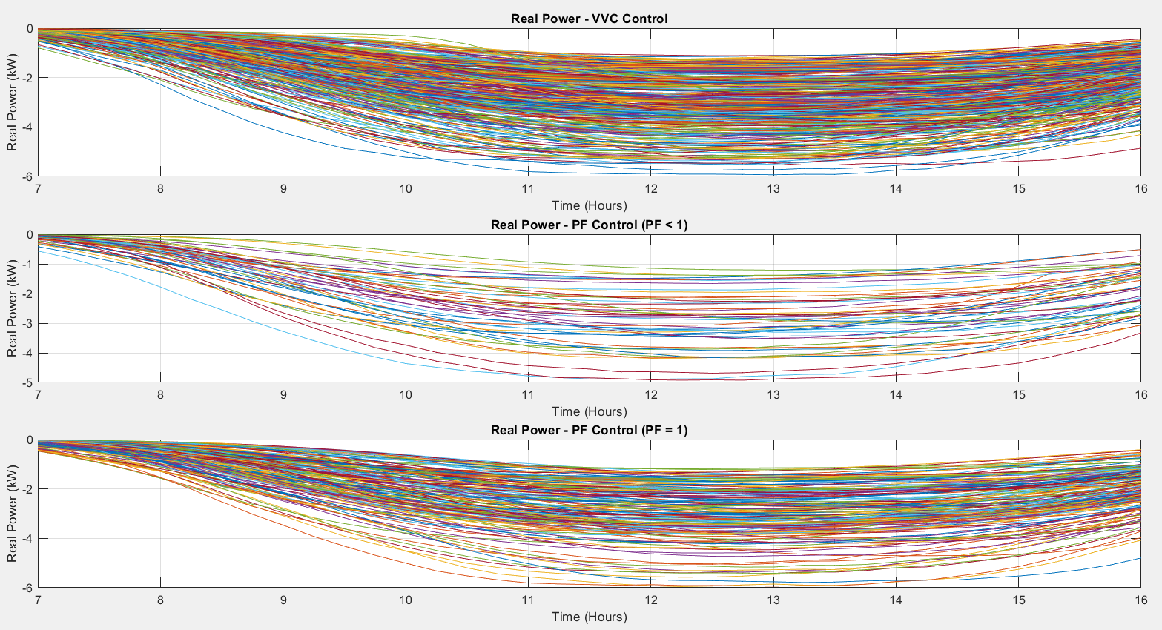
Net PV Active Power vs. Time
PV data

Slide 39
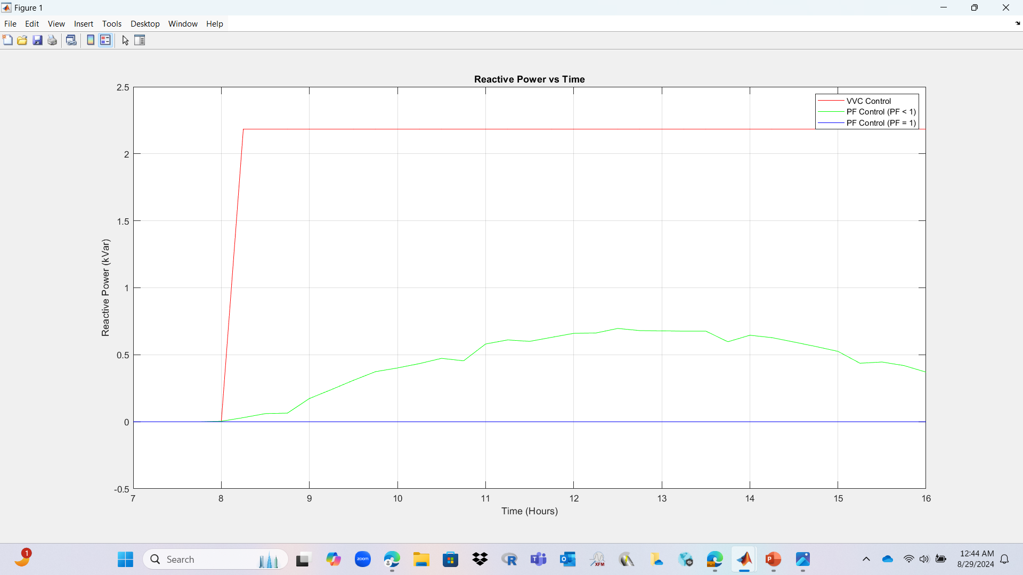
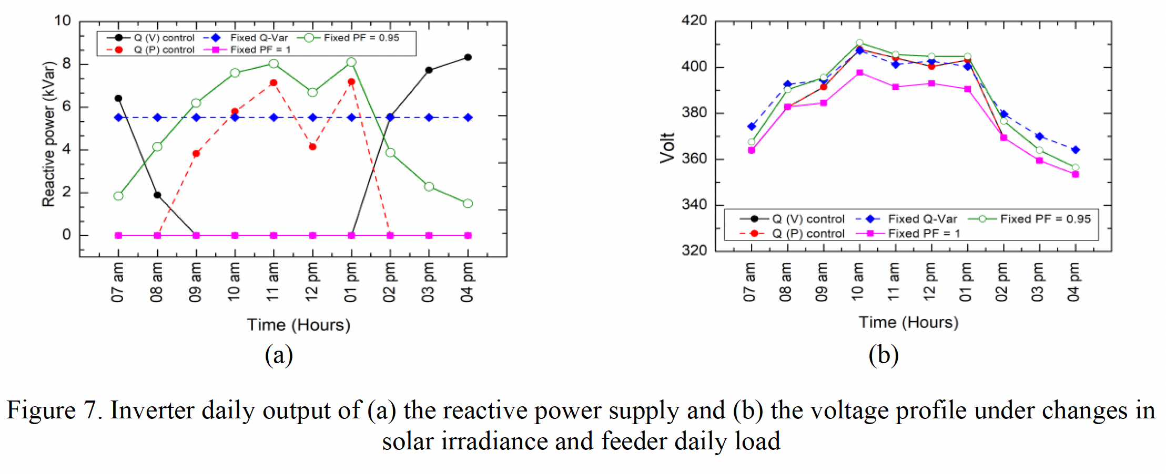
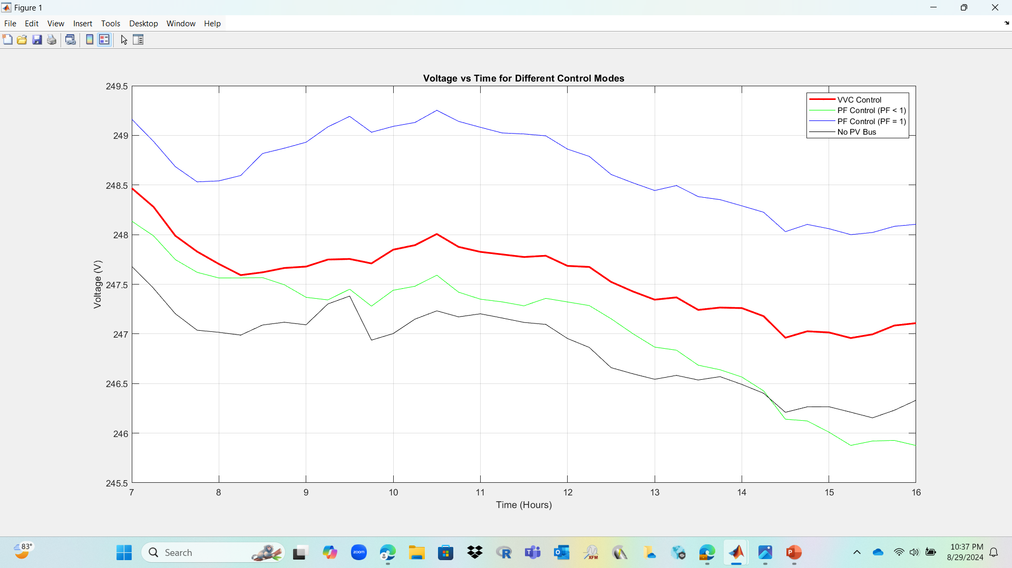
Supplementary Graphs
PV data

